Slide 1
Green Power Connect - Overview
October 17th, 2022
Green Power Connect Team

Slide 2
Agenda
GPC Team
Interconnection Process
Digital Solar Toolkit
Billing

Slide 3


Solar Process and Timeline
Step1: Completeness Check
Timeline: 10 business days
Definition: Complete Application Includes
Interconnection Agreement
Service and Meter Application
Specification Sheets
Plot Plan
Single-Line Drawing
Application Fee
Step 2: Initial Review
Timelines:
Level 1 – 15 business days
Level 2 – 20 business days
Definition:
Review documents for equipment locations, equipment specifications, etc.
Check circuit information, transformer information, and perform analysis from transformer to meter
After initial review, the application can be; approved, conditionally approved pending simple solution acceptance, or require an engineering study

Slide 4
Solar Process and Timeline
Step 2b: Simple Solutions
Timeline:
Varies with solution
Definition:
Application paper changes, design changes, small circuit changes that impact customers local to applicant. Ie. Lower kW, Upgrade Triplex, Change customer URD Cable, Move Pole or Transformer.
Step 2c: Engineering Study
Timeline:
Varies – typically 6-8 weeks
Definition:
PECO models the entire circuit serving the customer to find a solution. The solution will allow the full system size to be interconnected while not negatively impacting other customers. i.e. Phase swaps, regulators, capacitor banks fixed to switched, Change Auto Voltage Control (AVC) switch settings.
Step 3: Approved
Timeline
Varies depending upon initial review and next steps
Definition:
The customer’s application is approved for installation

Slide 5
Solar Process and Timeline
Step 4: Installation
Timeline
Varies, dependent on customer and solar developer
Definition:
Customer and solar developer install the approved system. PECO is not involved in this step.
Step 5: Metering
Timeline:
10 business days
Definition:
After PECO receives the Part II document, picture of meter box and inspection certificate PECO they will set the bi-directional meter (s) capable of reading power flow in and power flow out.
Step 6: Return Permission to Operate
Timeline:
10 business days.
Definition:
After PECO sets the customer’s meter, they will return the official Permission to Operate documentation to the customer and solar developer.

Slide 6
Digital Solar Toolkit
PECO.com/myGPC
Information regarding solar interconnections, billing videos, solar calculator and Q&A’s

Slide 7
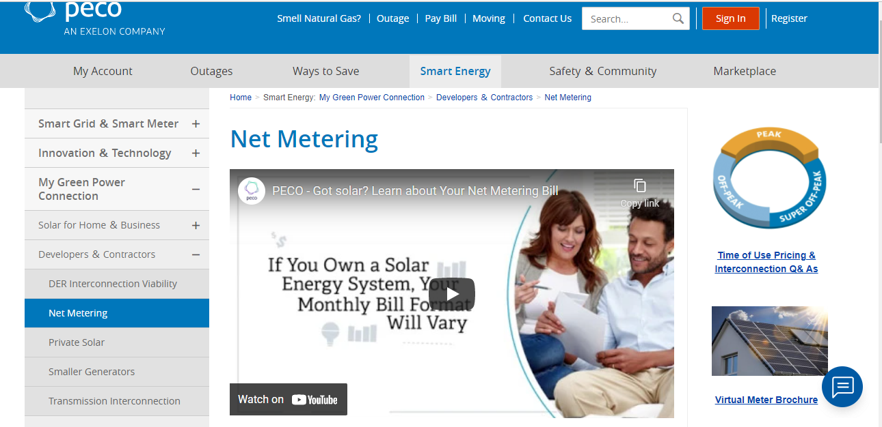
Digital Solar Toolkit

Slide 8
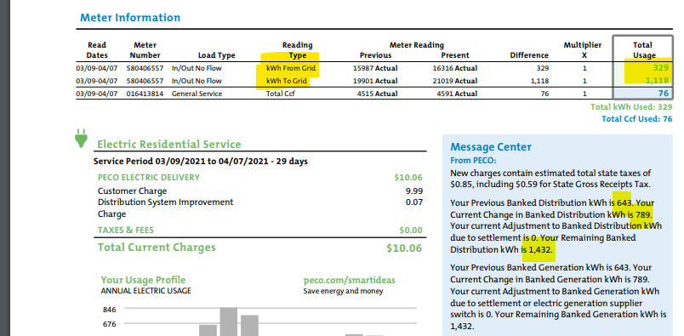
Billing Overview, Cont’d
Check with your 3rd party supplier to see what you are contracted for. 3rd party may not pay for excess production
If you are with PECO for generation, PECO will carry and excess kWh to the bank. If needed excess banked kWh
will be applied to your bill.
You will be credited 1 for 1 for each kWh off the PECO bill. Excess is placed in the bank.

Slide 9
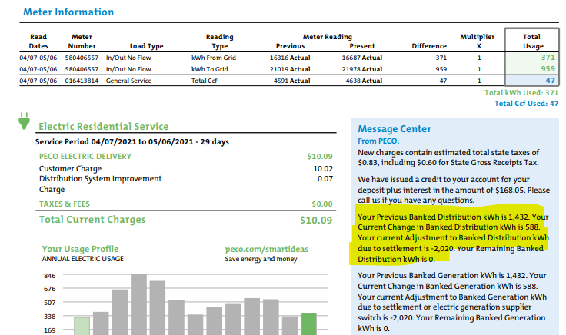
Billing Overview, Cont’d
At the end of the “PJM” year you are paid for excess generation at the Price to Compare (PTC) rate for generation only.
You can see your bank is reset to zero and you would start over.
You may want to consider calling customer service to be removed from budget billing.

Slide 10
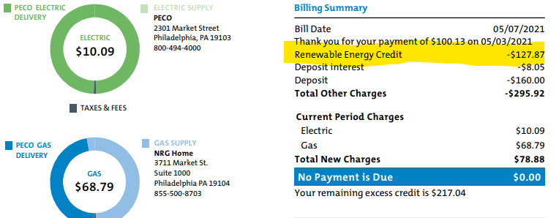
Billing Overview, Cont’d
In May you will see a renewable energy credit. If you take the credit and divide by the amount of kWh you will
see the credit per unit ($127.87/2020 = .063 cents per kWh).

Slide 11
Contact Us
PECO - Green Power Connect (GPC):
GPCTeam@PECO.com
(833) 732-6334

