Slide 1
RECYCLING Simplified!
Patty Barthel, Public Affairs, WM
Jennifer Smith, Public Sector Solutions, WM
Middletown Township EAC
February 28, 2023

Slide 2
What Makes Something Recyclable?
Collection
Convenience
Size/shape
Public education
All of these are necessary for sustainable recycling
Processing
Identification
Sorting
Size
End-Market
Demand
Volume
Value

Slide 3
What does that Recycle Symbol Mean?!
The symbol with three arrows pointing to one another is called the “chasing arrows” or sometimes a “Mobius loop.”
A plastic resin code, or ‘Resin Identification Code’, shows the consumer which type of plastic resin was used to make the chosen product, whether that be a plastic bottle, container or jug.
The recycle symbol does NOT mean you can throw the product in your recycling bin. It all depends on what’s accepted by your curbside recycling program.

Slide 4
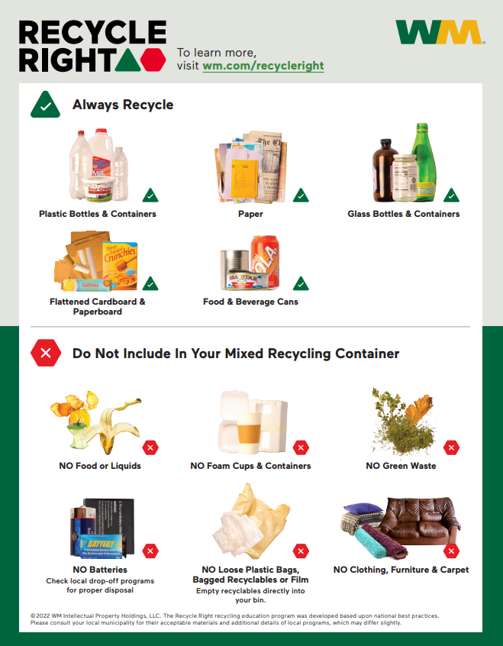
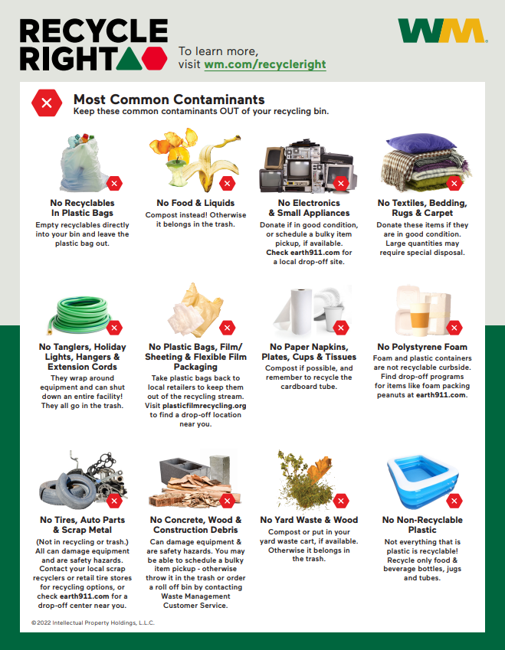

Slide 5
Consumer choice….
con·sume / kənˈso͞om
eat, drink, or ingest (food or drink).
buy (goods or services).
use up (a resource). utilize, expend
Decision making is the process of choosing between two or more alternatives; Consumer decision making may be defined as a process of gathering and processing information, evaluating it and selecting the best possible option so as to solve a problem or make a buying choice.

Slide 6
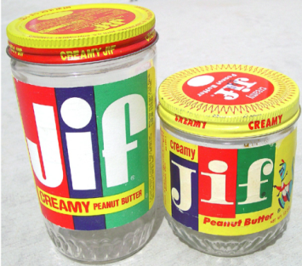
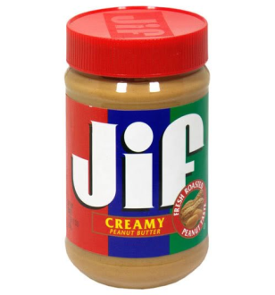
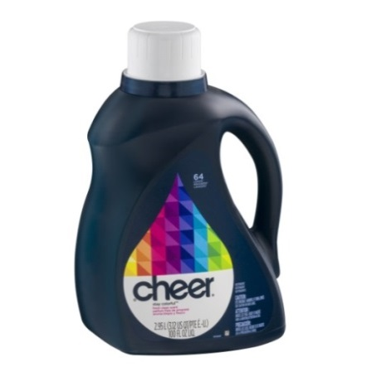
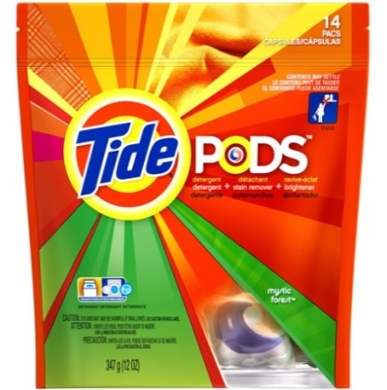
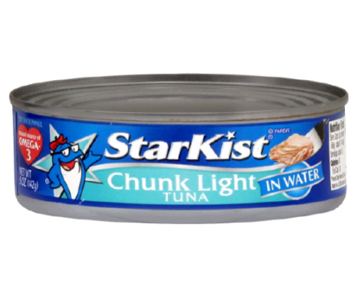
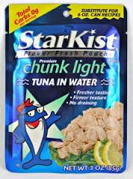
The evolving package
Light-weighting
Flexible packaging expected to grow 4-6% annually in the next few years
Glass jars, metal cap to PET jar, PP cap
HDPE Bottle, PP Cap to multi-layer, flexible film pouch
From steel can, paper label adhesive to multi-layer, foil-lined flexible film pouch

Slide 7
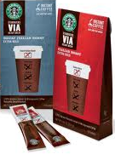
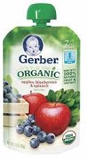
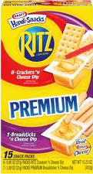
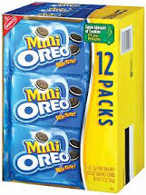
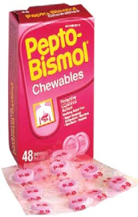
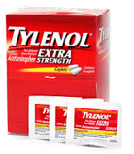
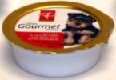
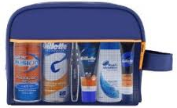
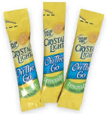
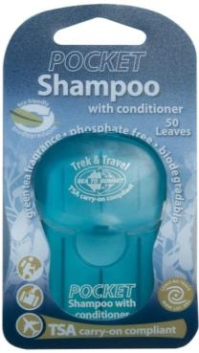
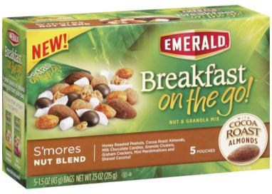
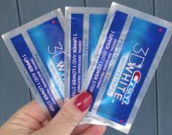
Consumer Behavior: On-the-Go Examples
Coffee
Baby Food & Formula
Cookies / Crackers
Pet Food
Pharma / OTC
Shaving
Nuts
Juice
Personal Care

Slide 8
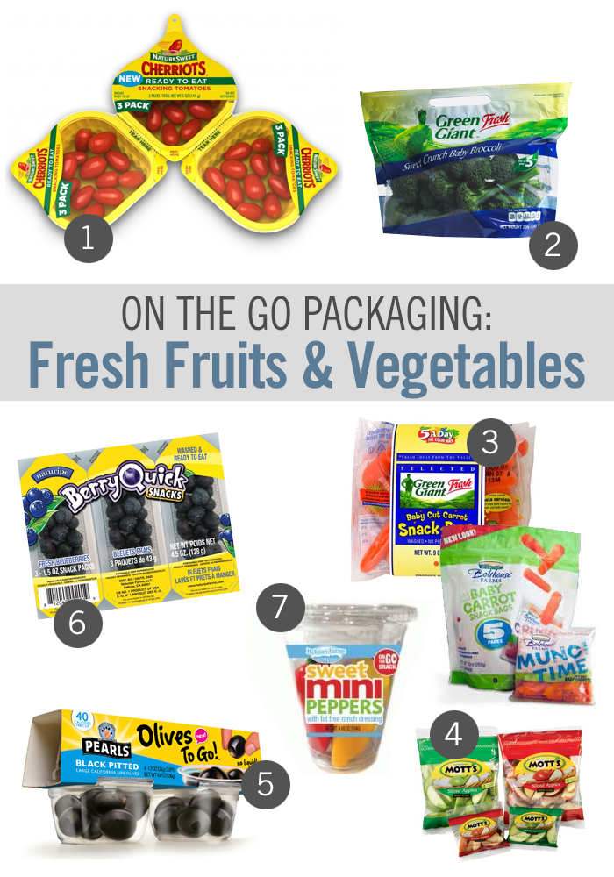
Implications
Less food waste
More custom packaging
More small packaging
More packaging that cannot be recycled in MRFs with existing technology
More packaging with no end markets

Slide 9
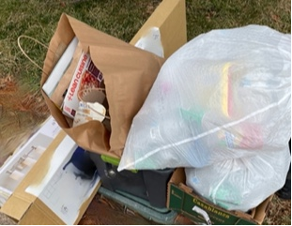
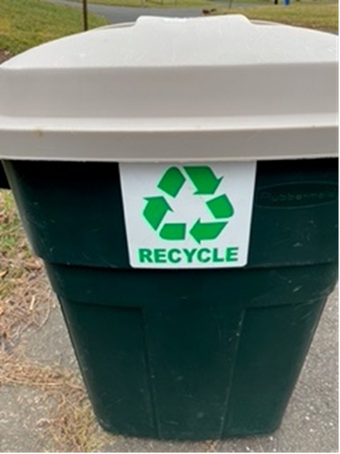
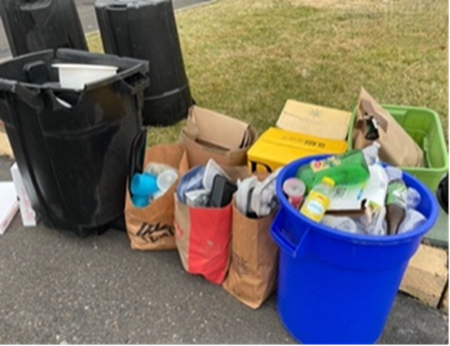
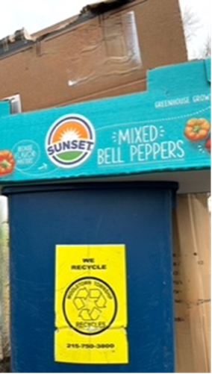
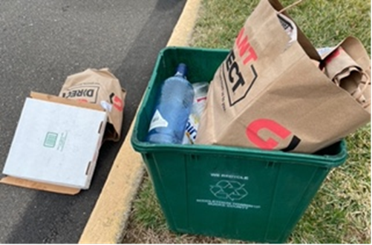
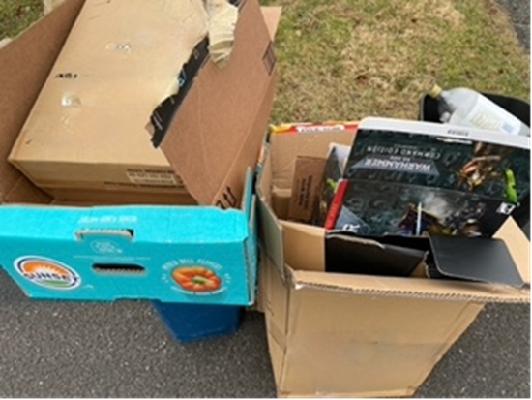

Slide 10
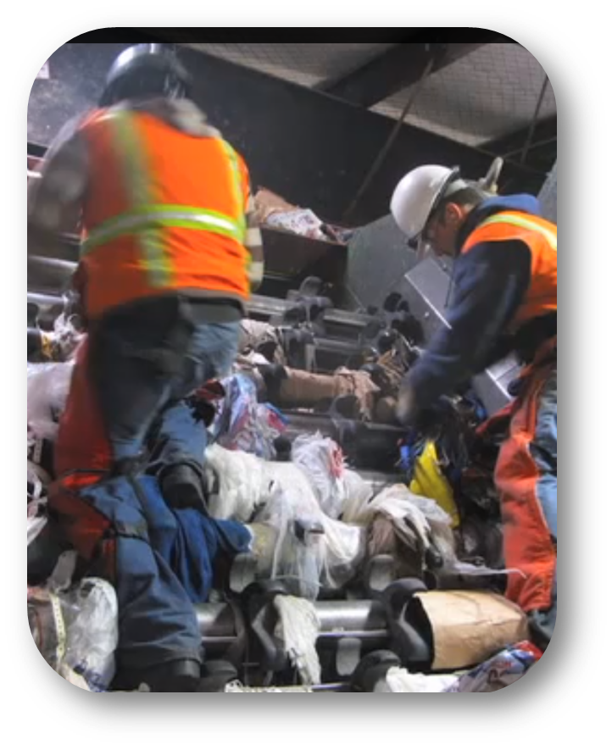
How Recycling Works
https://youtu.be/wsfE9ab8lg4

Slide 11
Typical Single Stream composition coming into Philadelphia Material Recovery Facility (MRF)
Composition by Weight
11% Plastics
3% Tin and Aluminum cans
43% Fiber
23% Glass
20% Residue (Trash)

Slide 12
OCC HISTORICAL PRICES
 | DATE |  | Avg. Price | Chicago | New England | Buffalo | New York
 | Feb-23 |  | $31.11 | $35.00 | $35.00 | $35.00 | $35.00
 | Jan-23 |  | $31.11 | $35.00 | $35.00 | $35.00 | $35.00
 | Dec-22 |  | $32.22 | $35.00 | $35.00 | $35.00 | $35.00
 | Nov-22 |  | $31.11 | $35.00 | $35.00 | $35.00 | $35.00
 | Oct-22 |  | $40.56 | $55.00 | $40.00 | $40.00 | $40.00
 | Sep-22 |  | $80.00 | $95.00 | $80.00 | $80.00 | $80.00
 | Aug-22 |  | $113.89 | $135.00 | $120.00 | $120.00 | $120.00
 | Jul-22 |  | $131.11 | $155.00 | $140.00 | $140.00 | $140.00
 | Jun-22 |  | $126.67 | $155.00 | $140.00 | $140.00 | $140.00
 | May-22 |  | $125.56 | $155.00 | $140.00 | $140.00 | $140.00
 | Apr-22 |  | $130.00 | $160.00 | $145.00 | $145.00 | $145.00
 | Mar-22 |  | $132.78 | $160.00 | $145.00 | $145.00 | $145.00
 | Feb-22 |  | $131.67 | $160.00 | $145.00 | $145.00 | $145.00
 | Jan-22 |  | $134.44 | $160.00 | $145.00 | $145.00 | $145.00
 | Dec-21 |  | $141.67 | $165.00 | $155.00 | $155.00 | $155.00
 | Nov-21 |  | $158.89 | $180.00 | $175.00 | $175.00 | $175.00
 | Oct-21 |  | $168.89 | $190.00 | $185.00 | $185.00 | $185.00
 | Sep-21 |  | $171.67 | $190.00 | $185.00 | $185.00 | $185.00
Supply and Demand
Weak Economy creates less demand for cardboard and other recyclables.
Cardboard – Less online buying, paper mill slows down, inventories rise, prices drop. When buying increases, inventories reduced, production demand grows, prices rise.
PET Plastic went from $400/ton to $200/ton in same timeframe.
For instance, Mohawk Carpets, HUGE buyer of PET. In slow economy, public isn’t buying or replacing carpets, demand and prices for PET drops.

Slide 13
Buyer Commodity
Mohawk Carpets PET Plastic (polyester fiber, carpet)
Anheuser-Busch Aluminum Cans (beverage cans)
Georgia Pacific Fiber (tissue, construction products)
Pratt Industries Fiber (packaging, shipping)
West Rock Fiber (packaging, shipping)

Slide 14
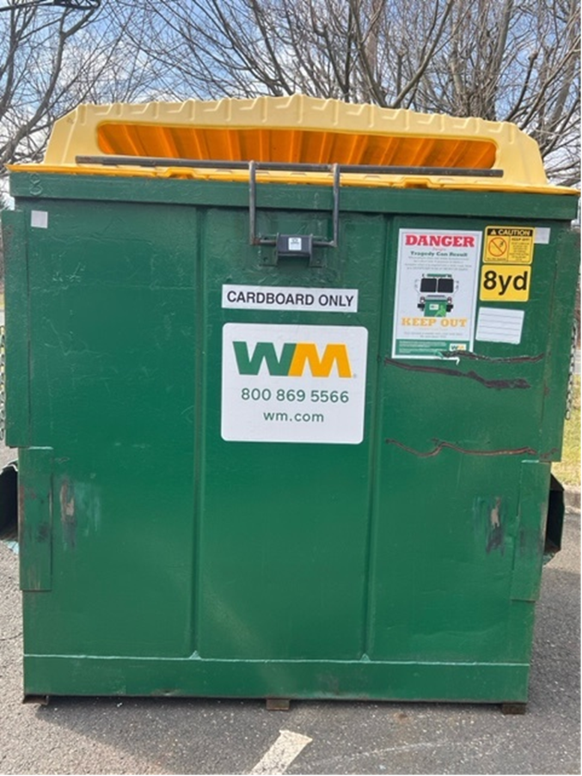
Two 8 Yard dumpsters, emptied weekly
Dumpsters are available 24 hours a day.
CARDBOARD ONLY
Middletown Township Community Park
-Langhorne Yardley Road
Middletown Township Dept. Public Works
- Veterans Highway

Slide 15
Household batteries of all types can be a danger to our employees, vehicles and the community.
Recycle and Dispose with great care.

Slide 16
Thank you.
Questions?

Slide 17
