Slide 1
Rain Gardens
Middletown Township Environmental Advisory Council
March 28th, 2023
Fred S. Lubnow, Ph.D.
With offices in New Jersey, Pennsylvania, Maryland and Connecticut
flubnow@princetonhydro.com

Slide 2
Outline of Presentation
Brief history of stormwater management.
Stormwater Management with Structural BMPs
What are rain gardens?
Ecosystem services.
Examples of rain garden projects

Slide 3
History of Stormwater
Prior to the 1980s the primary concern over stormwater was flooding and safety.
However, as the Clean Water Act (established in 1972) was addressing point source pollution, the impacts of non-point source (NPS) began to be realized.
The CWA was amended in 1987 to include regulating urban stormwater through National Pollution Discharge Elimination System permits.
In the early 1990s the municipal separate storm sewer systems (MS4s) were initiated.

Slide 4
History of Stormwater
Through the 1980s flooding concerns.
Then began to use many of the large conventional structure Best Management Practices (BMPs) to address stormwater (retrofitting).
Focusing more on water quality and addressing the peak flow.
Developing Green Infrastructure (GI) to provide valuable ecosystem services.
Larger issues with connectivity / resiliency.

Slide 5
Four Modes of Treating Stormwater
Settling (removal of particulate material)
Infiltration (putting water back into the ground)
Chemical (adsorption of pollutants)
Biological (microbial / plant assimilation)

Slide 6
Types of Structural Best Management Practices (BMPs)
Volume / Peak Rate Reduction by Infiltration BMPs (includes rain gardens as well as infiltration basins)
Volume / Peak Rate Reduction BMPs (vegetated roofs and capture / reuse)
Runoff Quality / Peak Rate BMPs (constructed wetlands, wet ponds, retention basins)
Restoration BMPs (riparian buffers, soil amendments, floodplain restoration)
Other BMPs (level spreader, addressing parking lots)

Slide 7
Typical Dry Detention Basin
Originally designed for flood control.
Not intended for water quality control.
Suspectable to re-suspension of solids.
Typically addresses larger drainage areas.

Slide 8
Conversion of dry basin into an extended detention basin
Relatively easy to retrofit a dry basin into an extended detention basin.
Existing land already dedicated to stormwater management.
The conversion enhances its ability to remove pollutants and improve water quality.
A number have been converted in the Core Creek / Lake Luxembourg watershed.

Slide 9
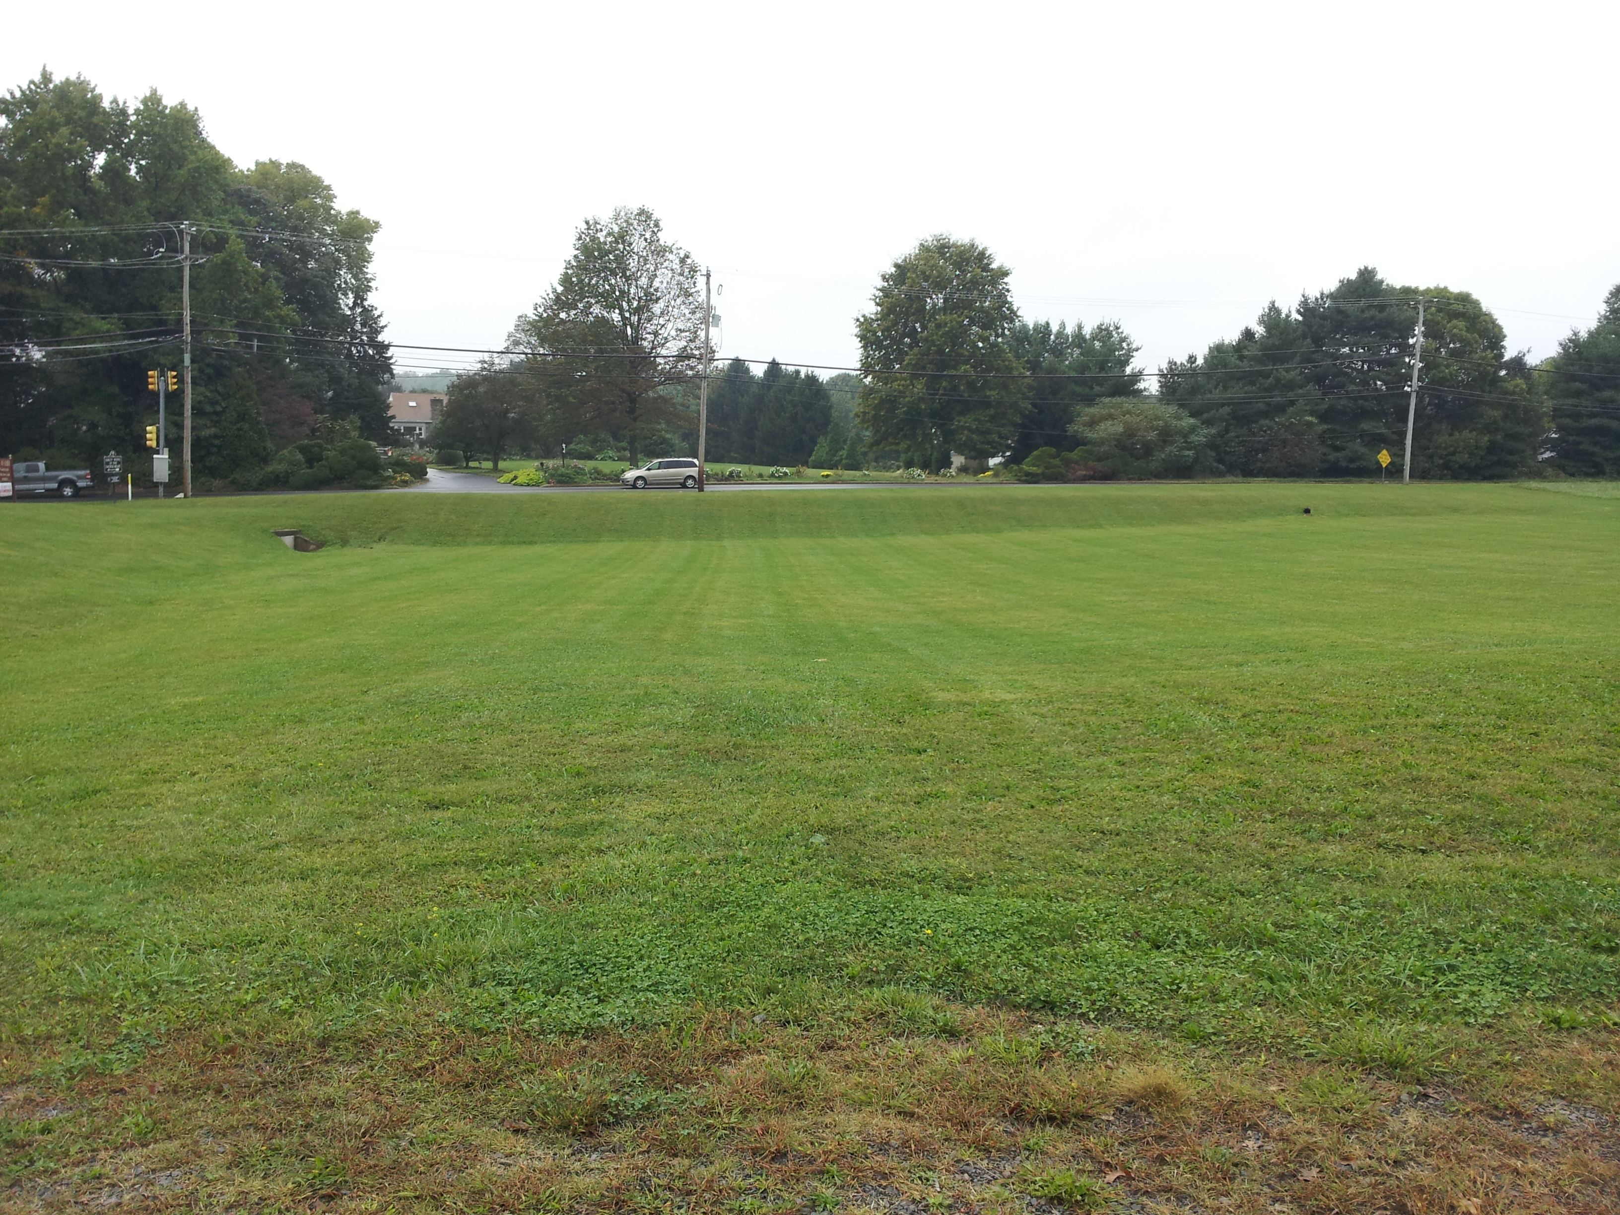
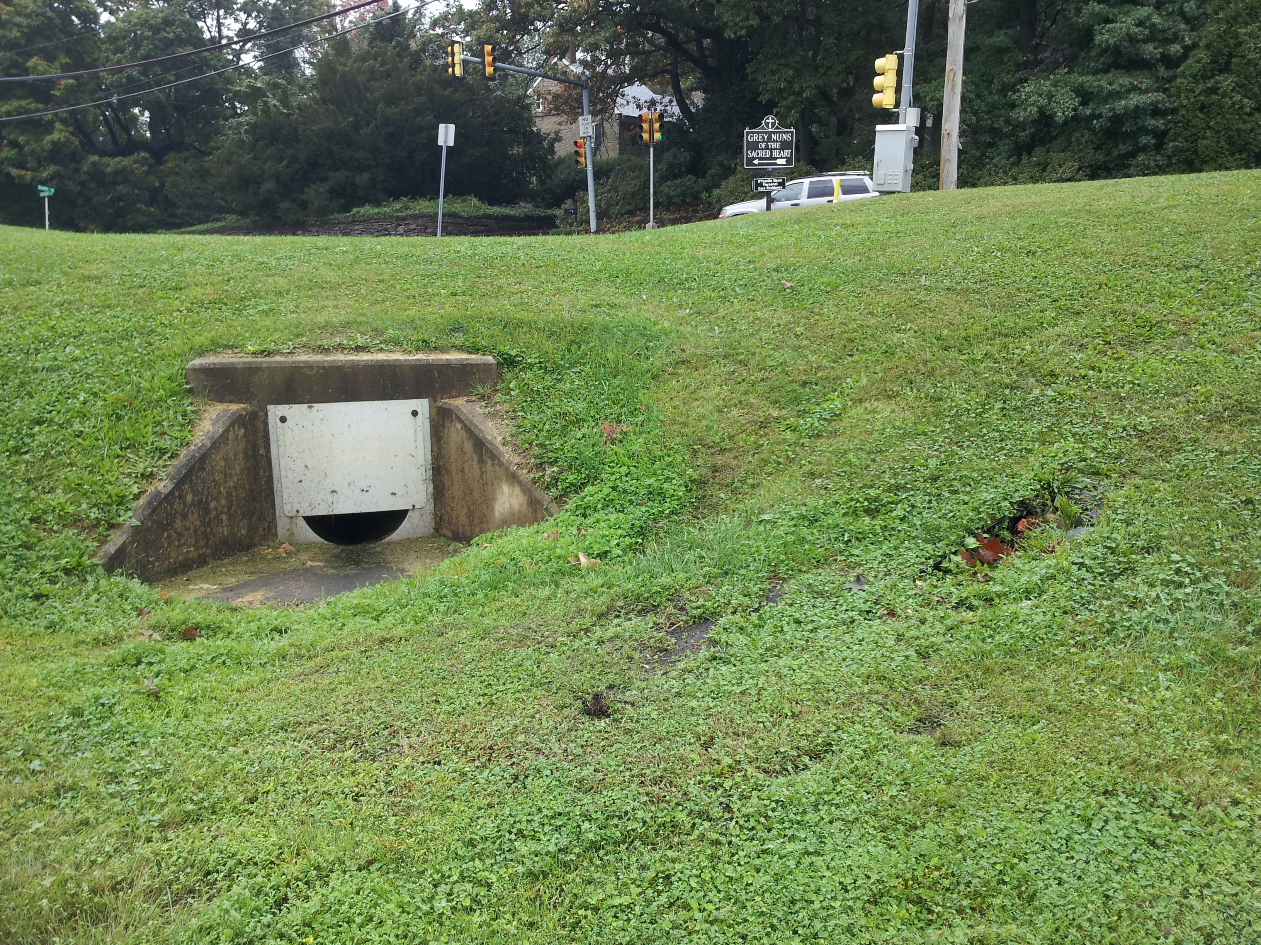
Grey Nun Academy Basin CC – G54
(Before)

Slide 10
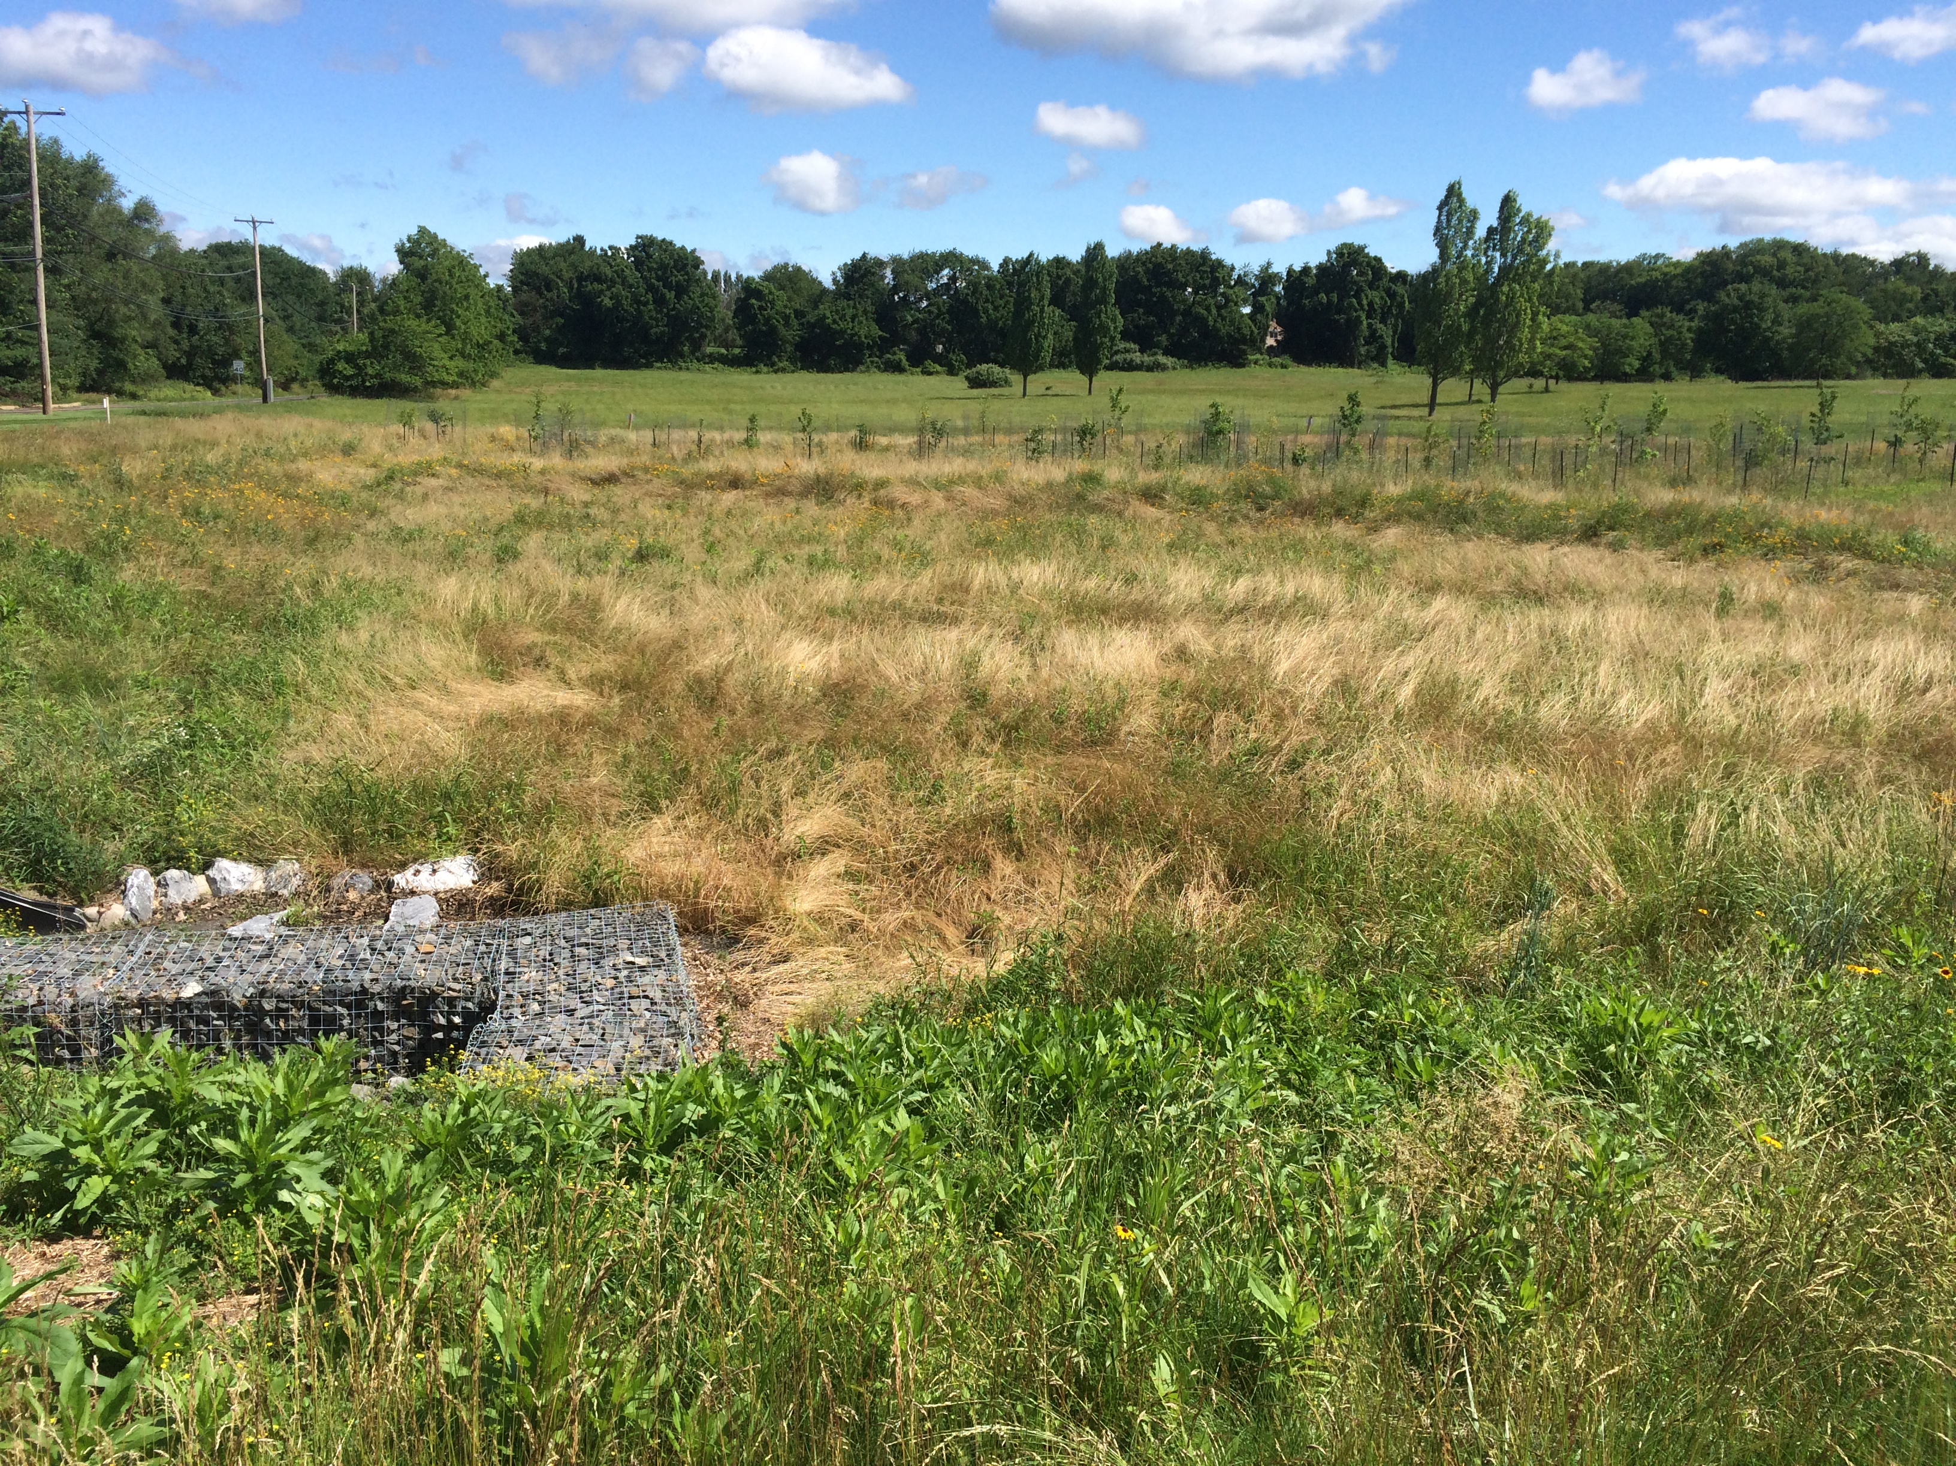
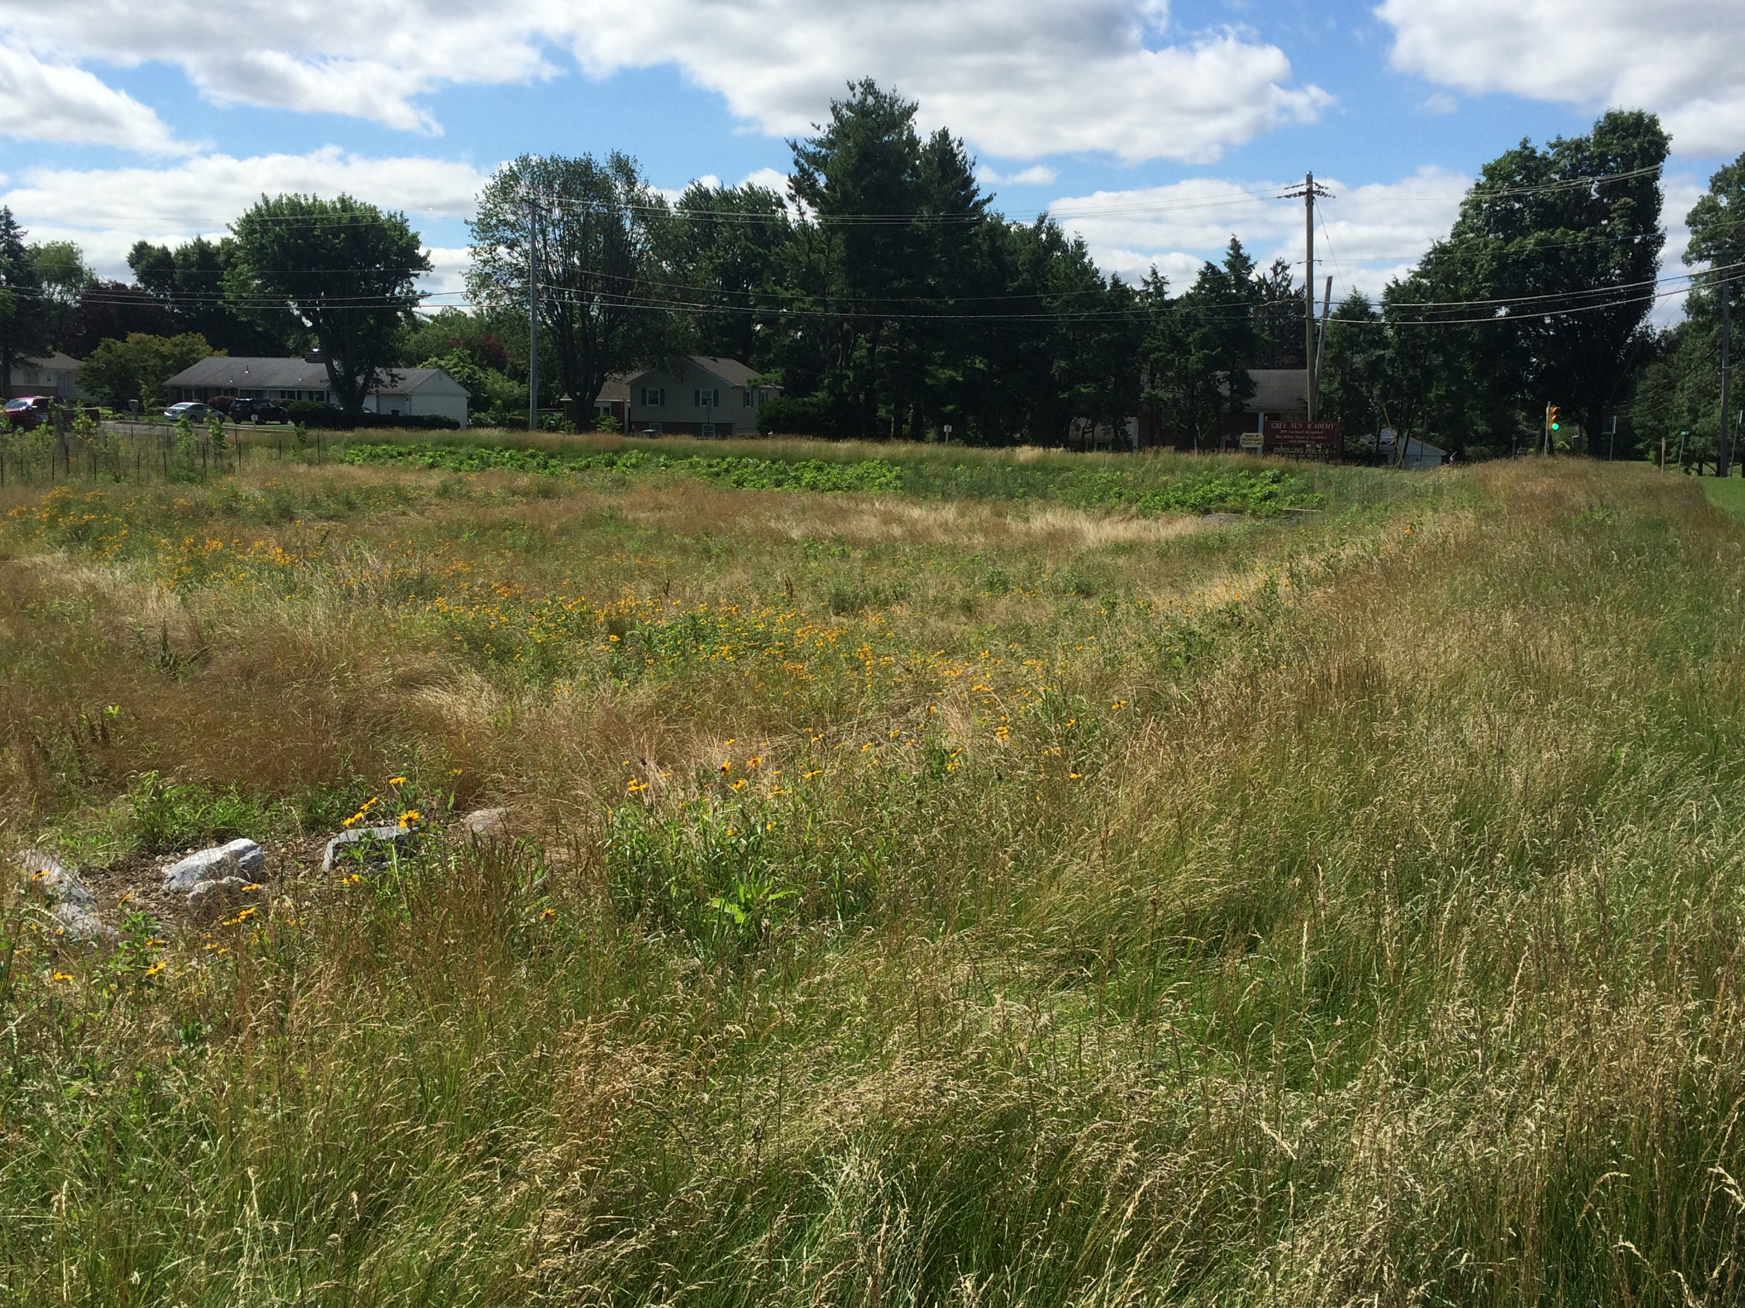
Grey Nun Academy Basin CC – G54
(After)

Slide 11
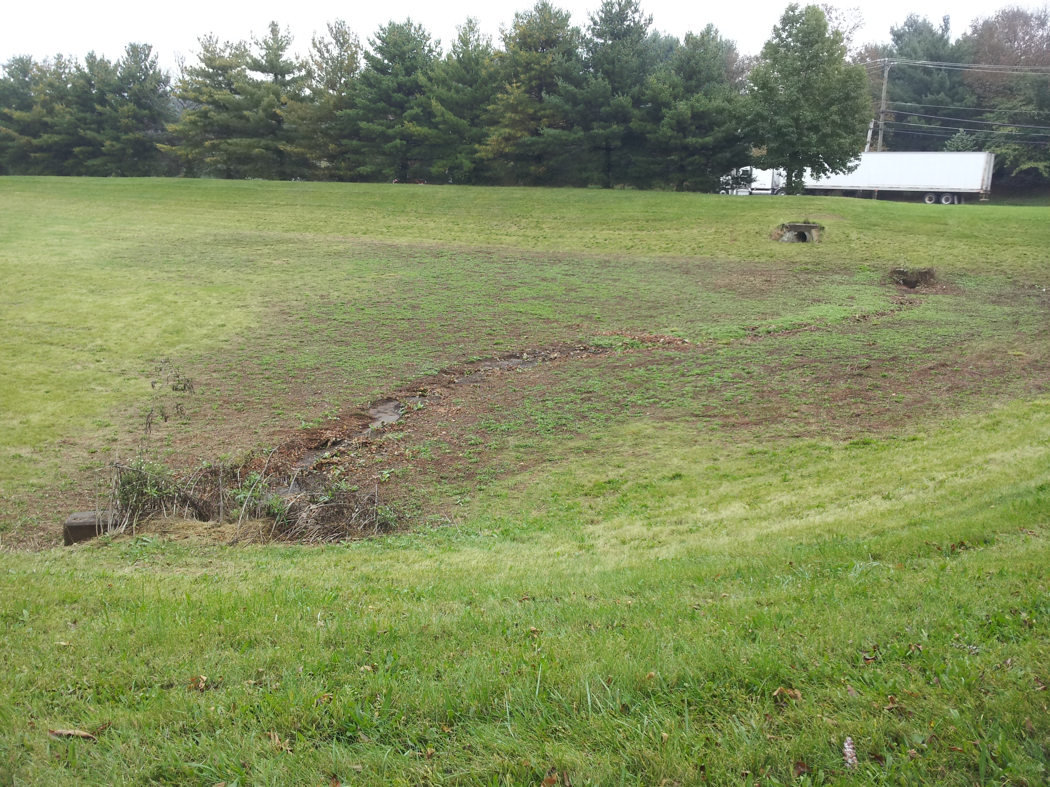
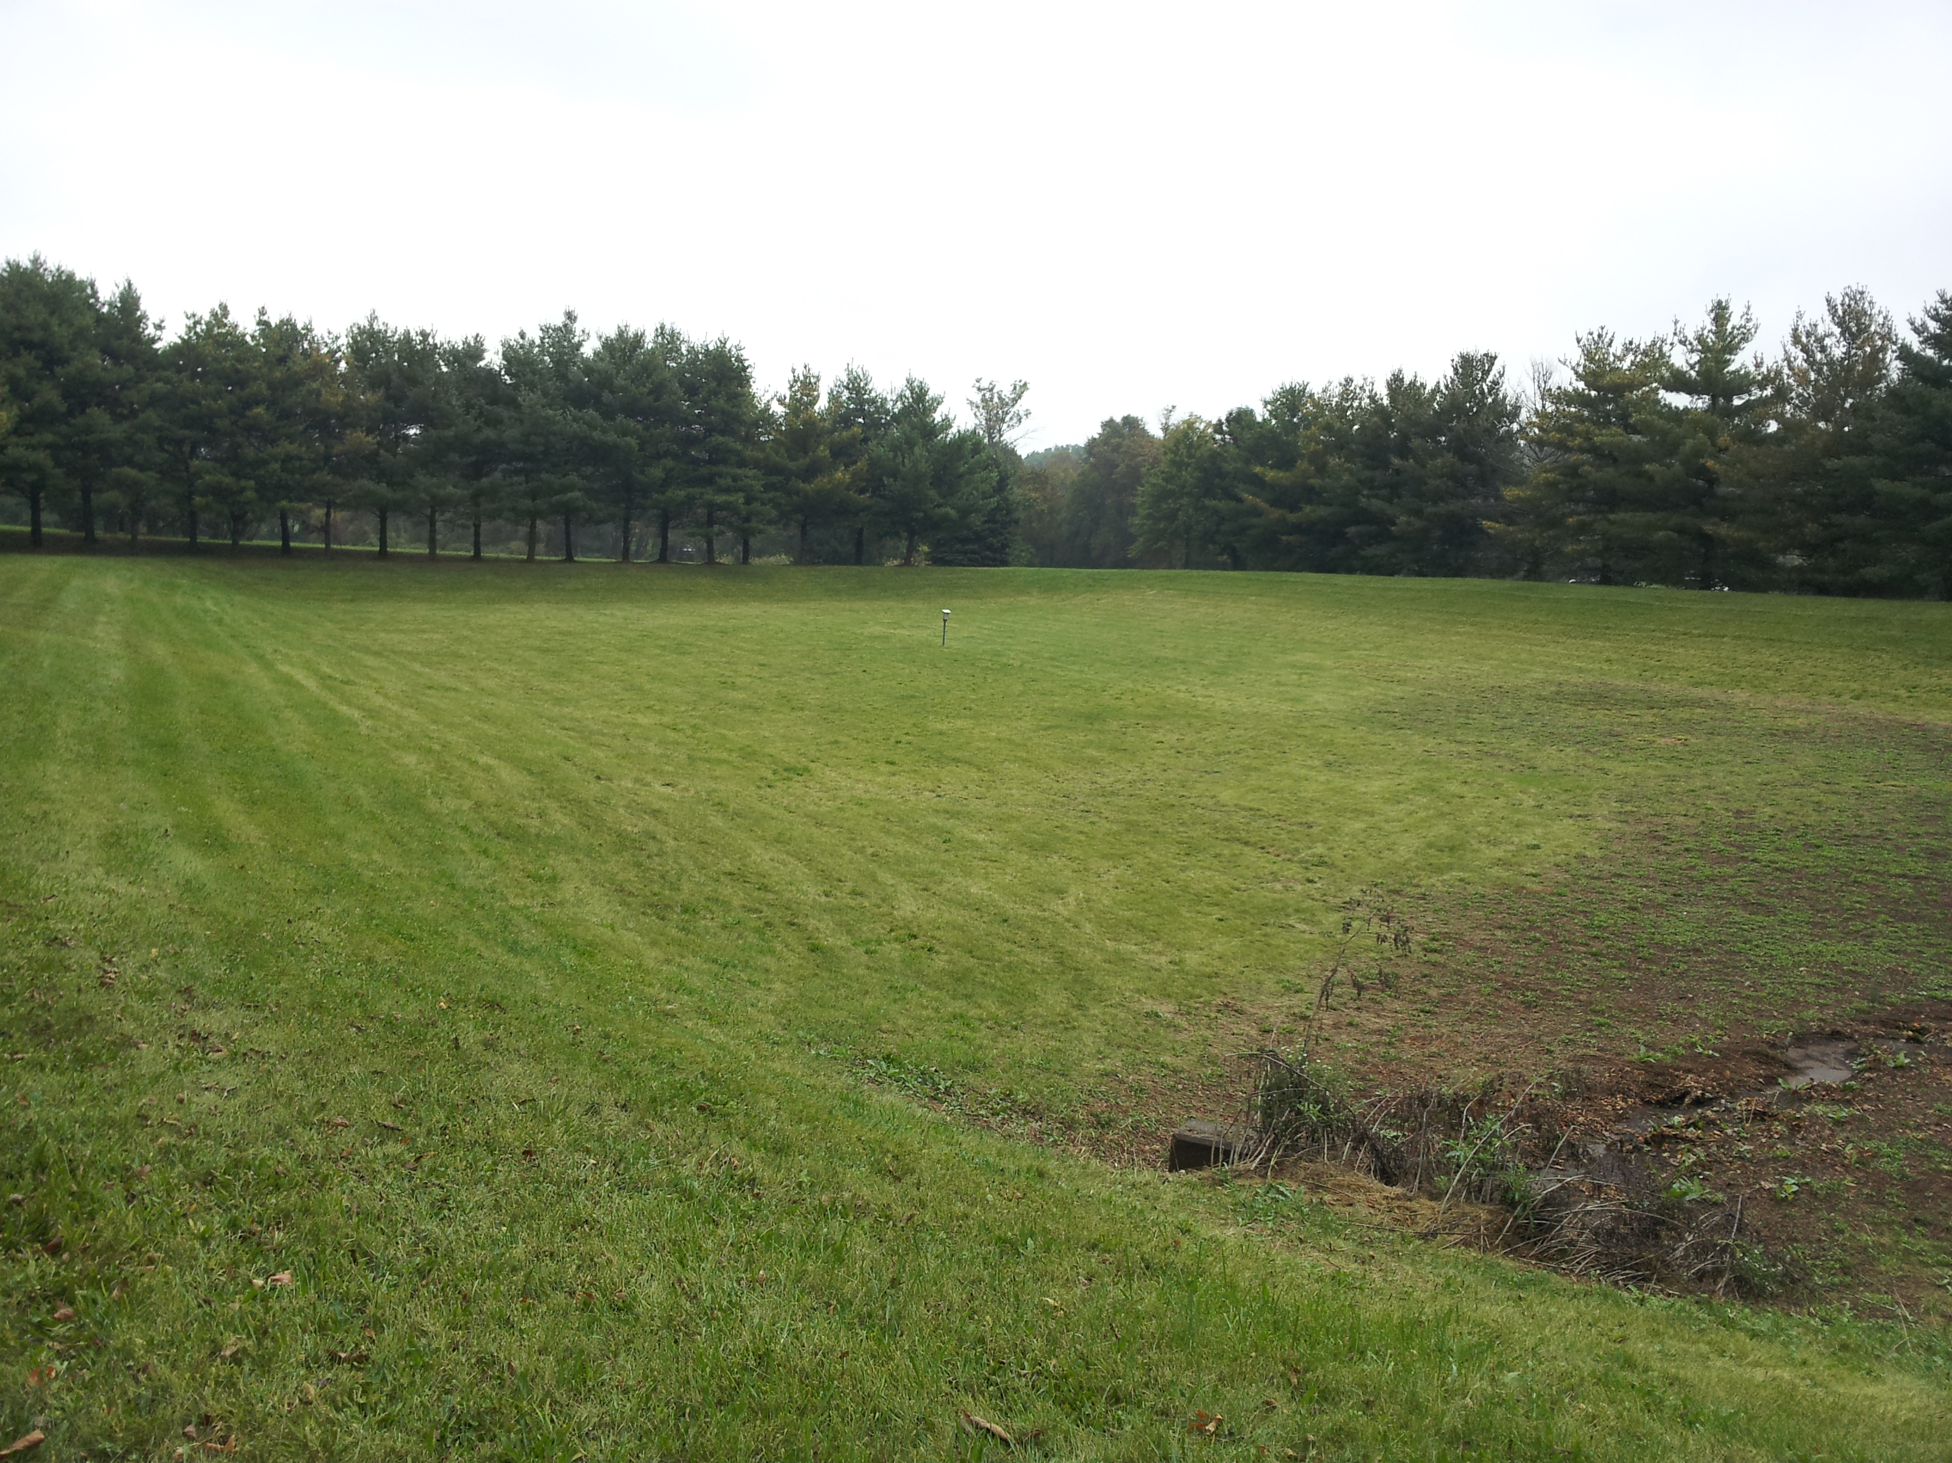
Heather Ridge Basin CC – E63
(Before)

Slide 12
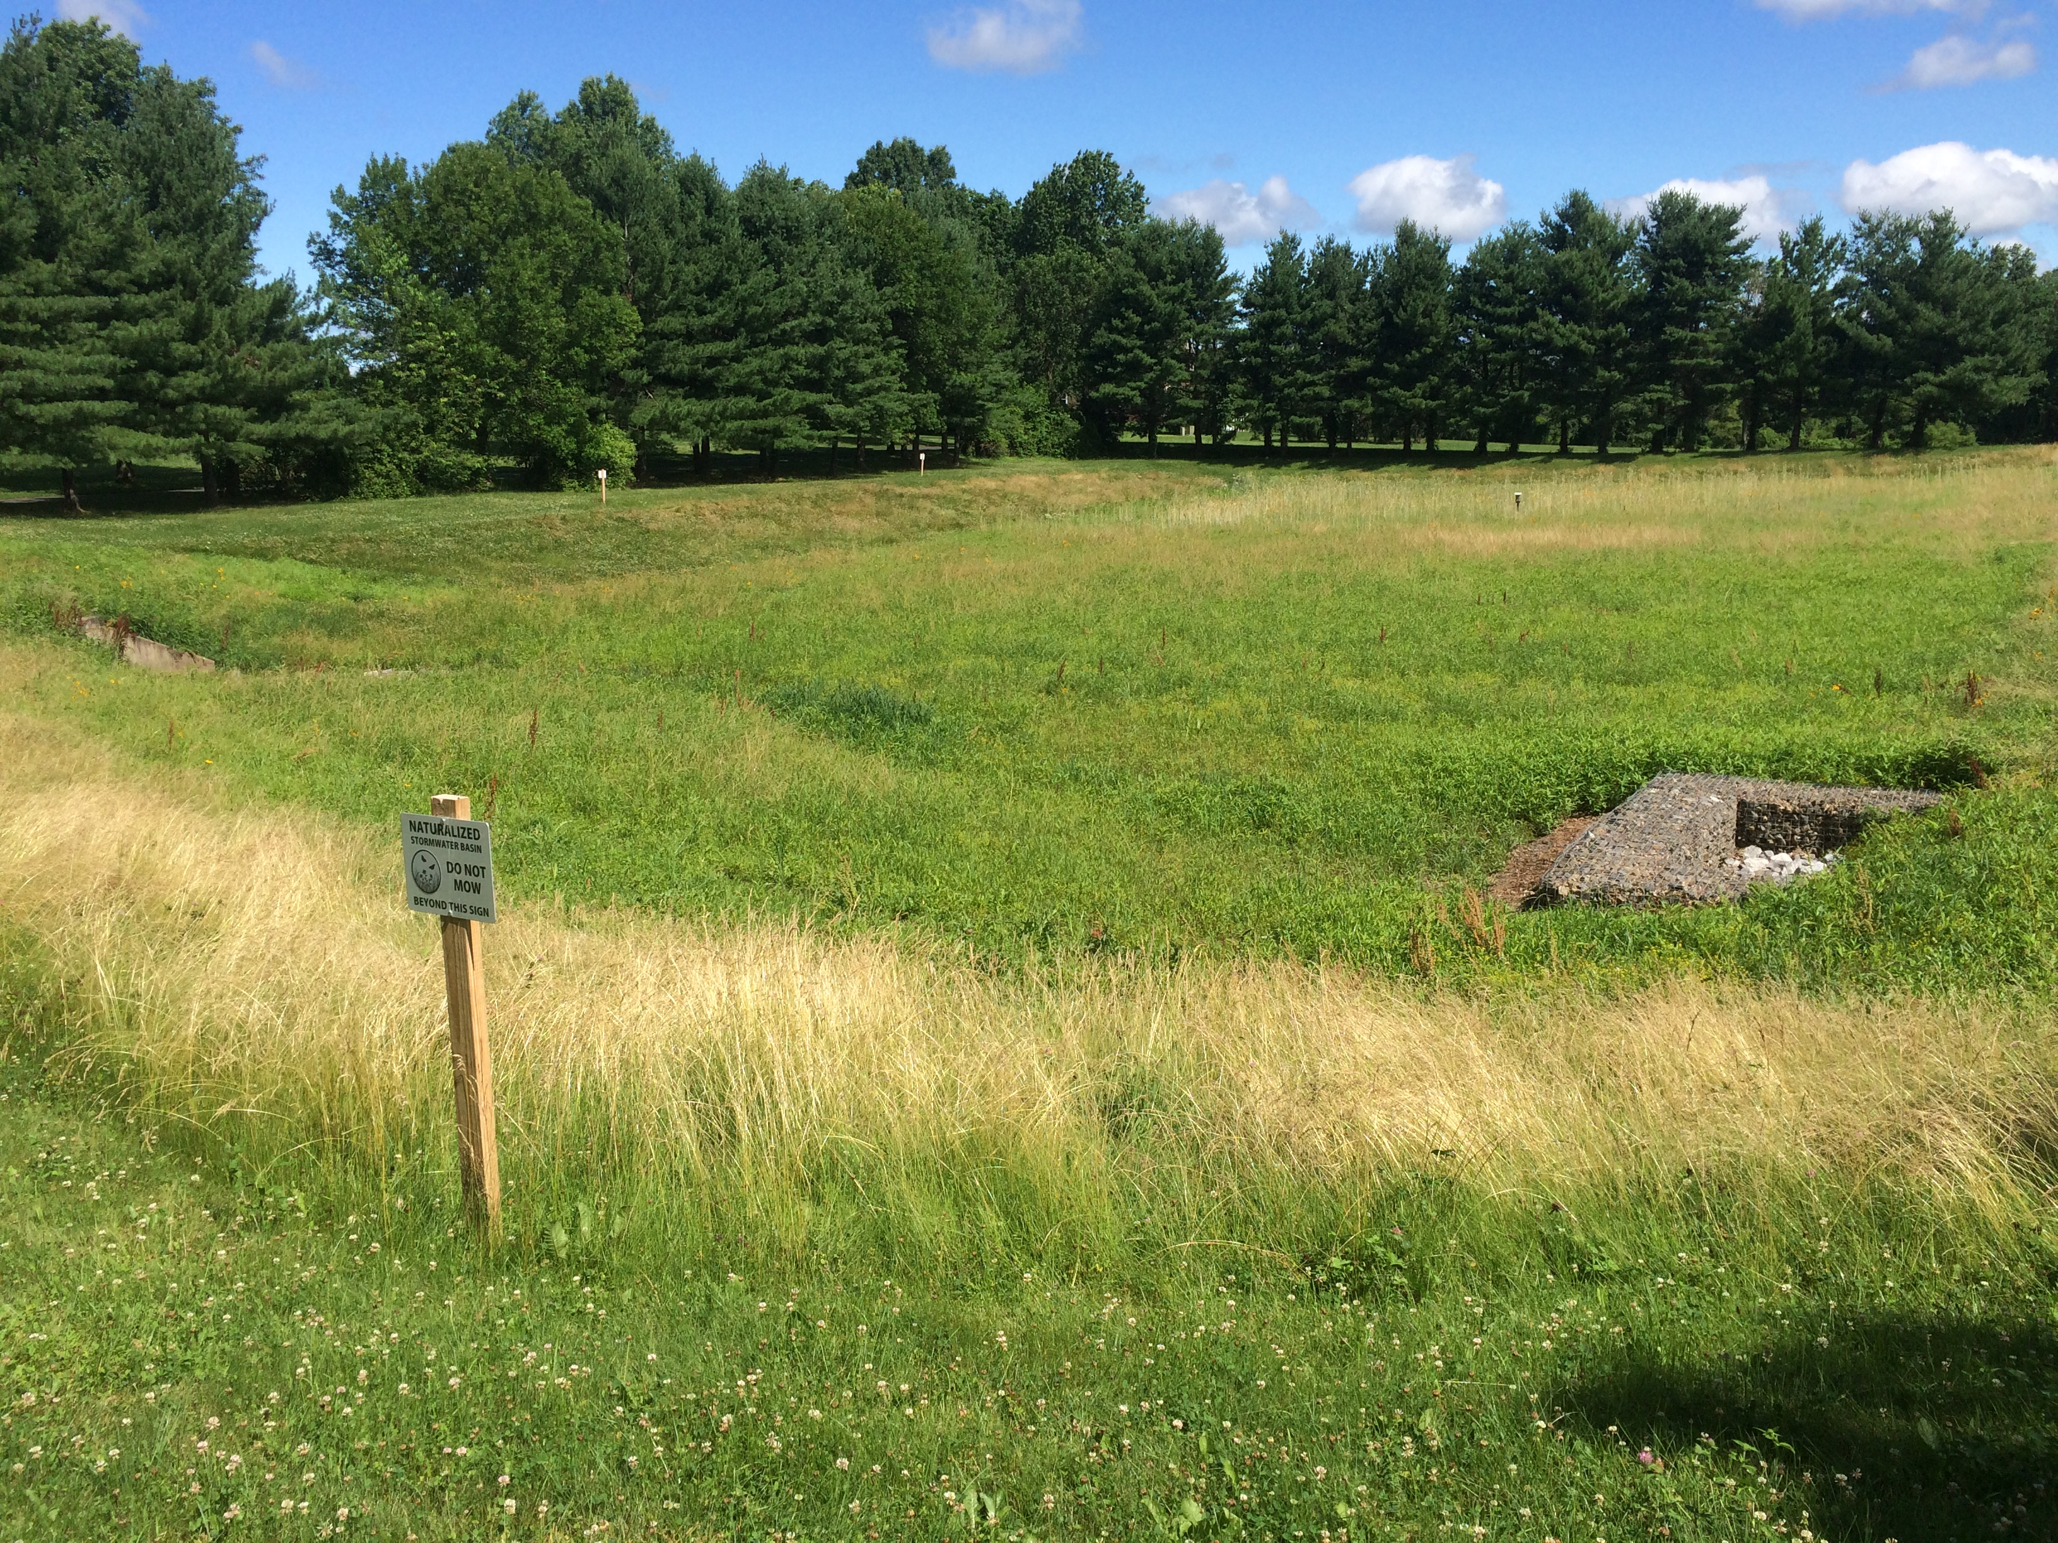
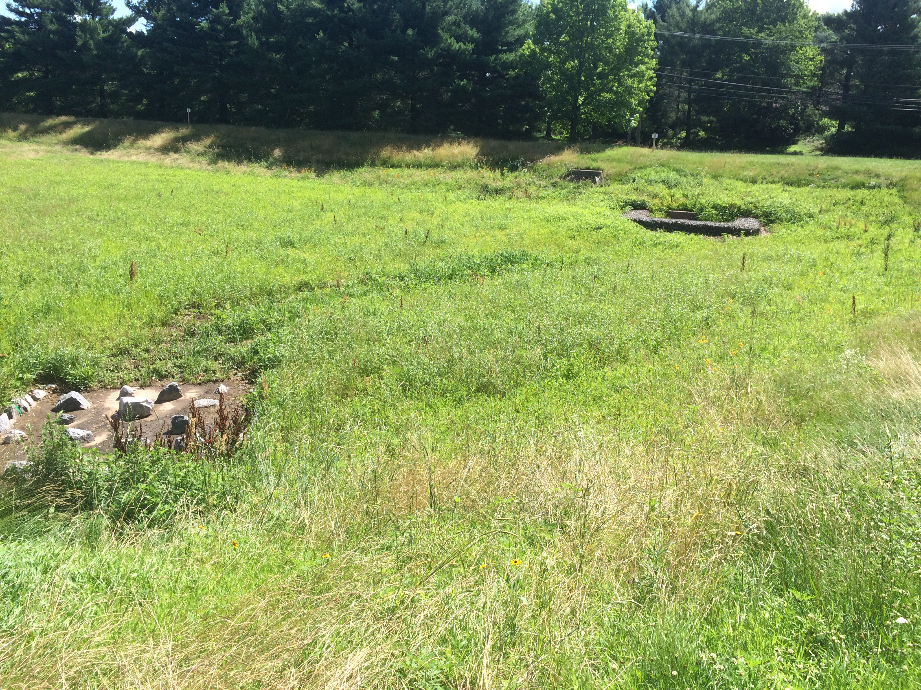
Heather Ridge Basin CC – E63
(After)

Slide 13
Ecosystem Services
Soils – aid in infiltration of runoff, aid in removing pollutants and contribute toward reducing severity of flooding.
Riparian vegetation – aid in cooling of streams / nearshore areas, stabilize area and reduce erosion, reduce pollutant loading, contribute toward complex food webs.
Trees – contribute toward stabilization of soils, reduce pollutant loading and can have a substantial contribution toward reducing flooding.

Slide 14
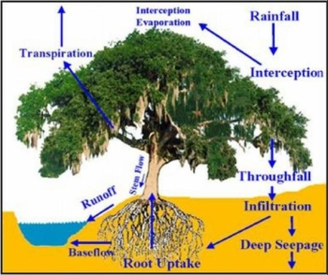
Stormwater Benefits of a Tree

Slide 15
Stormwater Benefits of a Tree
Bioretainment
A tree’s canopy has an annual retention of approximately 20% of the precipitation.
One tree has the capacity to reduce stormwater runoff by over 4,000 gallons per year.
A forest of approximately 10,000 trees will retain approximately 10 million gallons of rainwater per year.
One acre of Douglas-fir gases-out about 46 tons of water vapor over the course of a sunny, summer day (approx. 5,550 gallons per day).

Slide 16
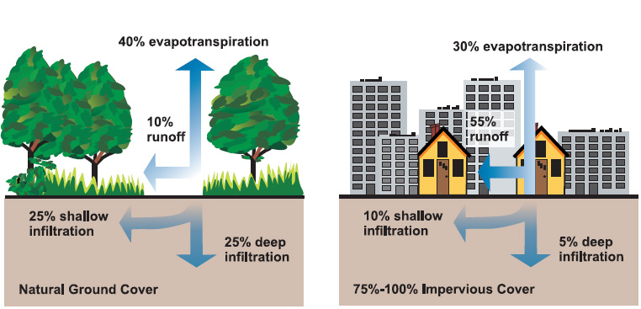

Slide 17

Ecosystem Services – Complex Food Webs
Enhances fishing, enhances pollination, minimize / avoid nuisance species, including mosquitos.
A third of our crops are pollinated by bees; animals are responsible for pollinating 87% of plants and 90% of all flowering plants.
Biodiversity – birds.

Slide 18
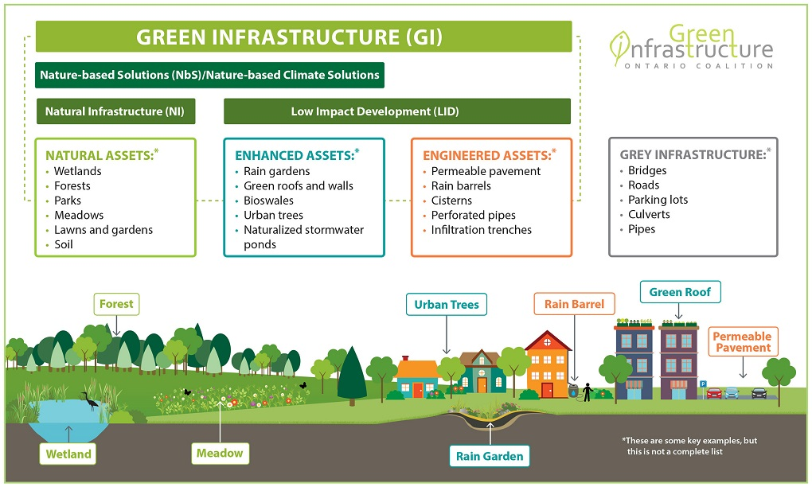
Green Infrastructure
Rain Gardens
Pervious Pavement
Green Roofs
Enhanced Riparian Areas
Naturalized infiltration basins (basin retrofits)
Bioswale (vegetated swales or strips)

Slide 19
Rain Gardens / Bioretention or Biofiltration Systems
A rain garden is an excavated, shallow depression, planted with native vegetation to treat and capture surface runoff.
Flexible in terms of size, design and rates of infiltration.
Deep rooted native perennials and trees that are tolerant of hydrologic variability, road salts and other stresses.
High removal rates; TSS and TP of 85% and nitrate of 30%.
Uses all 4 modes of stormwater treatment.

Slide 20
Rain Gardens – Design Considerations
Need moderate rate of infiltration (> 0.1 inches per hour).
For soils with high clay content, should remove 1-2 feet of soil and replace it with a mix of 50-60% sand, 20-30% topsoil and 20-30% compost.
Others suggest a mix of 30% sand, 30-40% loamy topsoil and 30% organic material (compost).
The key is the soil should be dominated by a loamy sand and should drain within 12 to 48 hours.

Slide 21
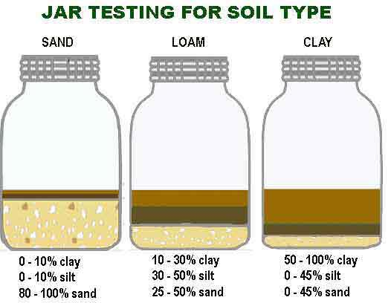

Slide 22
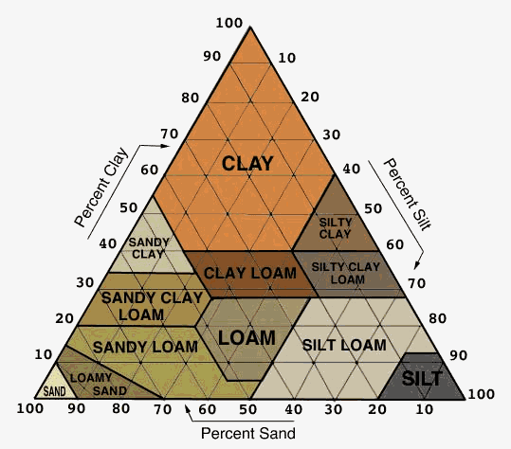

Slide 23
Rain Gardens – Design Considerations
Drainage to rain garden ratio of around 5:1.
Ponding of water should be between 6 to 12 inches.
Planting soil depth should be at least 18 inches deep for herbaceous plants.
However, soil depths should be deeper if trees and woody shrubs are used.
The pH of the soil should be between 5.5 and 6.5.

Slide 24
Rain Gardens – Estimated Costs
DYI Rain Gardens – between $1 to $7 per square foot
Professional Rain Gardens – between $10 to $15 per square foot
Large commercial / institutional Biofiltration Systems – between $35 to $55 per square foot.
Note, cost estimates do not include design work or associated annual maintenance.

Slide 25
Rain Gardens – Maintenance
May require watering during first year.
May also require goose netting / fencing.
Some weeding may be required, particularly for invasive species.
Some detritus / trash may need to be removed and some perennials may need some cutting once a year.
Inspections for sediment build up (twice a year).
Inspect trees / shrubs for health twice a year.
May need supplemental watering during extensive droughts.

Slide 26
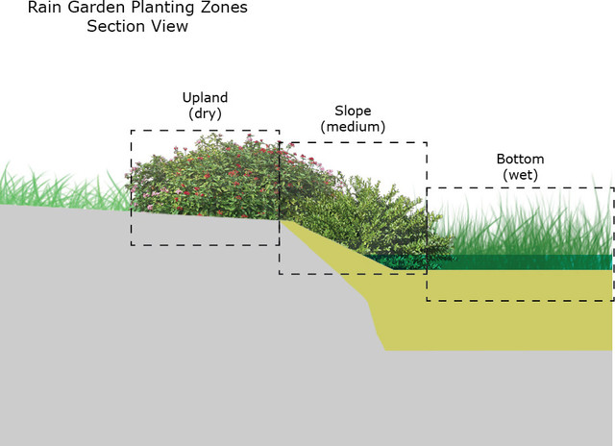

Slide 27
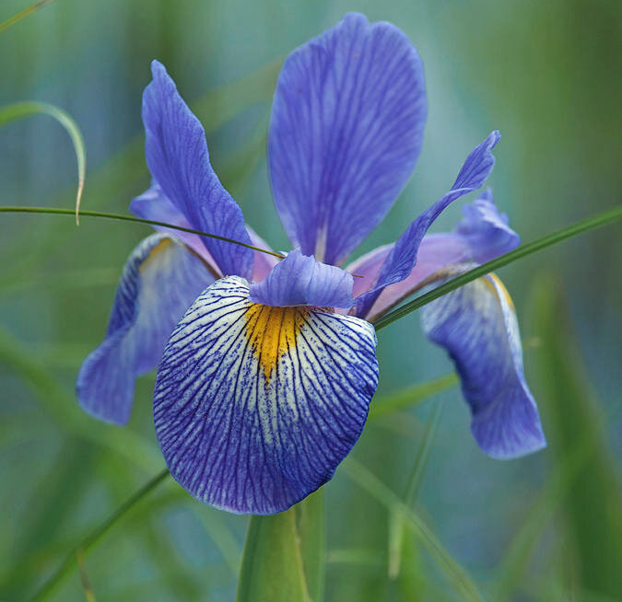
Zone 1 – Wet Zone
Inundated with water that infiltrated 24 – 48 hours.
Elderberry and Winterberry.
Blue flag iris, Cardinal flower, Cinnamon fern, New England aster and Swamp milkweed.
Black willow, swamp oak and red maple.

Slide 28
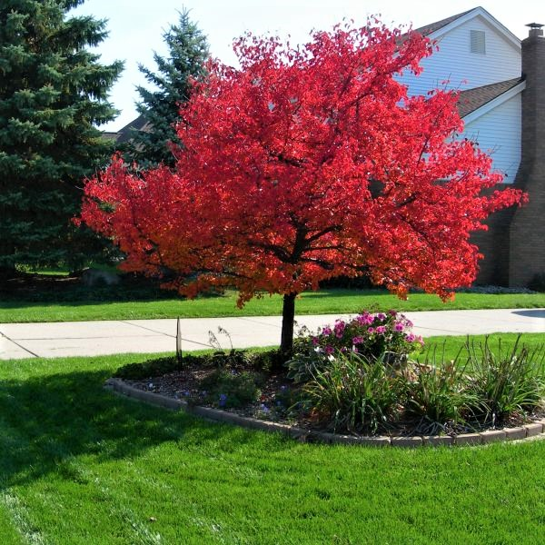
Zone 2 – Mesic (middle; slope) Zone
Inkberry, Red-osier dogwood, Sweet pepperbush.
Blue star, Broom sedge, Mistflower.
Red maple and Serviceberry.

Slide 29
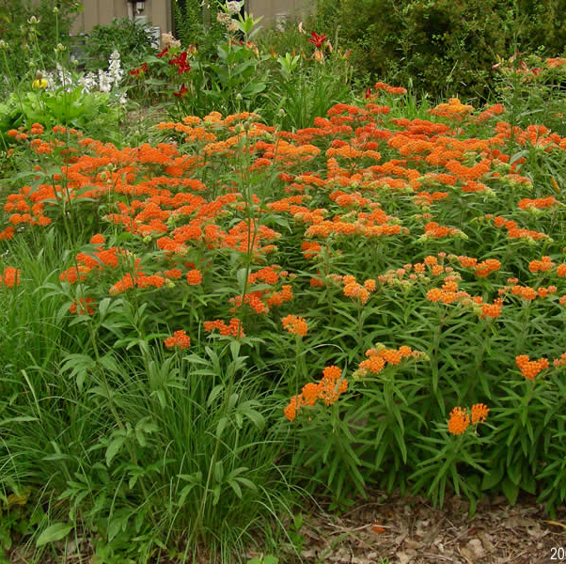
Zone 3 – Transition (upland; dry) Zone
Black chokeberry, gray dogwood, Witch hazel.
Butterfly weed, Golden aster, Evening primrose.
Buckeye and Staghorn sumac.
Rain Gardens - the Plants (psu.edu)

Slide 30
Where NOT to install a Rain Garden
Where the seasonal high-water table is within 24 inches of the soil surface (little infiltration).
Do not place a rain garden on a location that is constantly wet. The rain garden should completely drain within 24 hours.
Rain gardens should not be placed over a septic system.
Rain gardens should not be located adjacent to building foundations. Should be at least 10 feet from the house.
Before you dig, call PA One Call 811 or 800-242-1776.

Slide 31
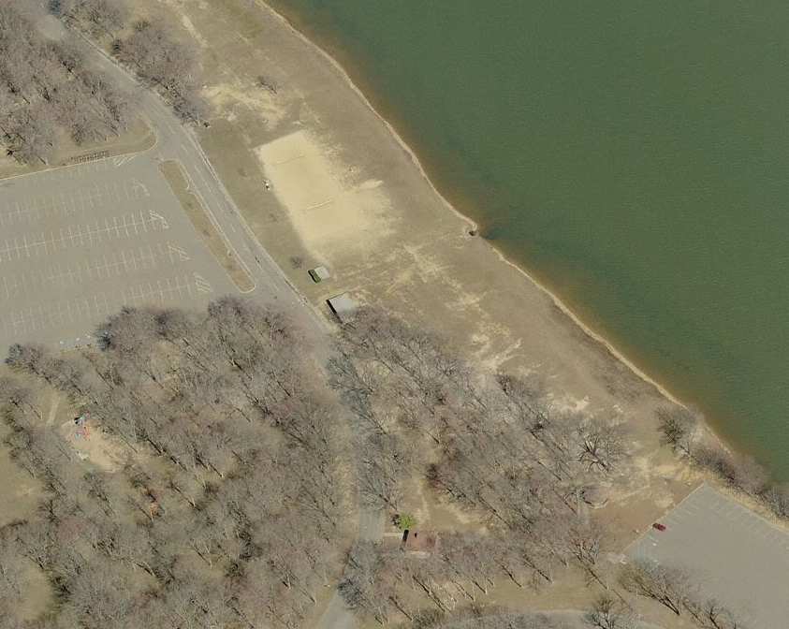
Thompson Park, Jamesburg, NJ
Manalapan Brook / Lake Restoration Plan.
Has a TMDL that focuses on TP and TSS.
Has implemented a variety of stormwater projects and one of the first was this Biofiltration System.
Linear Rain Gardens along Parking/Drive ways

Slide 32
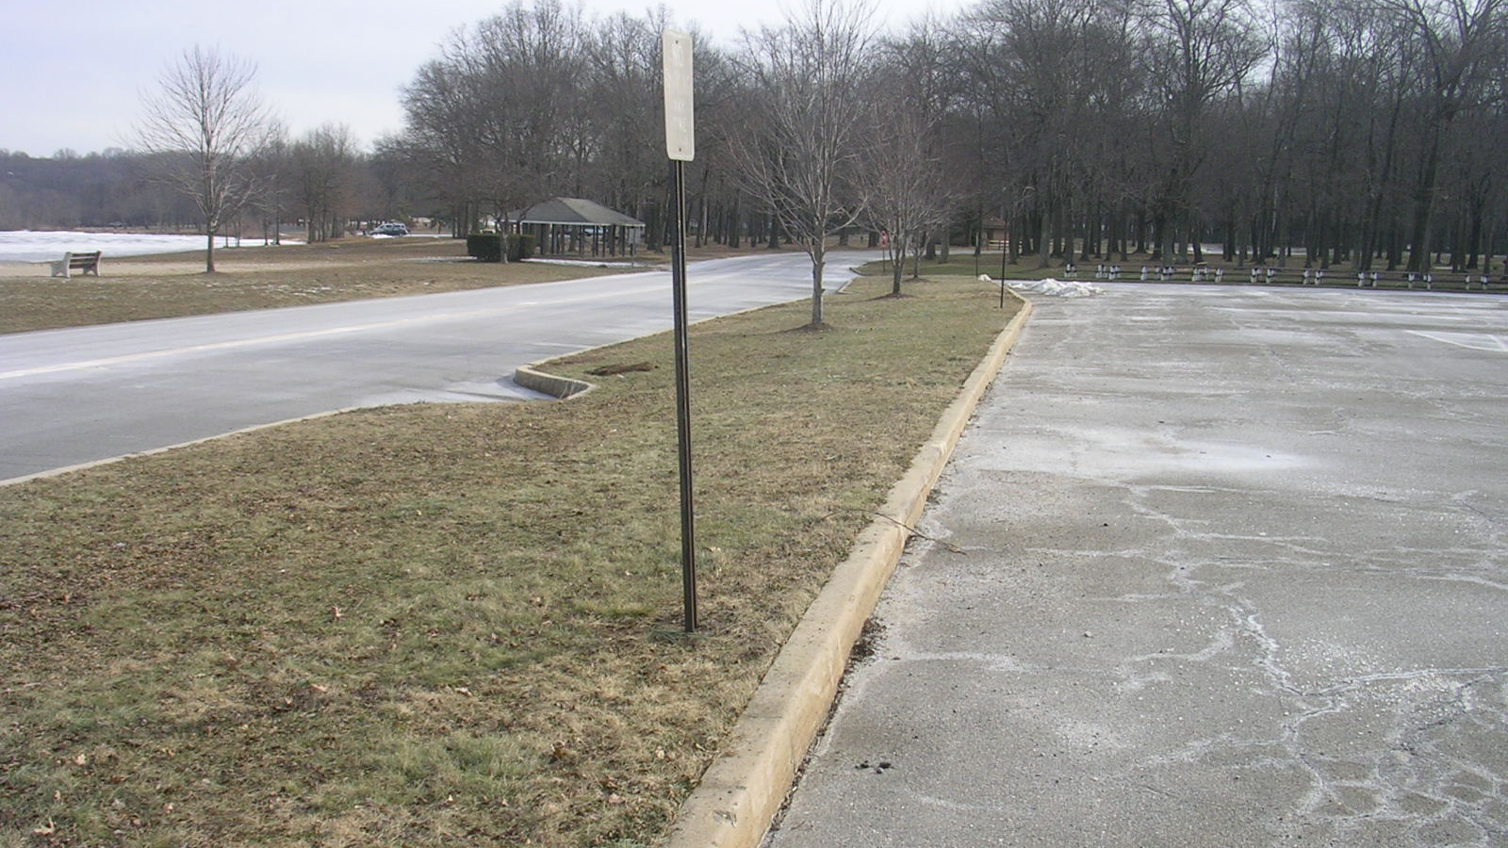

Slide 33
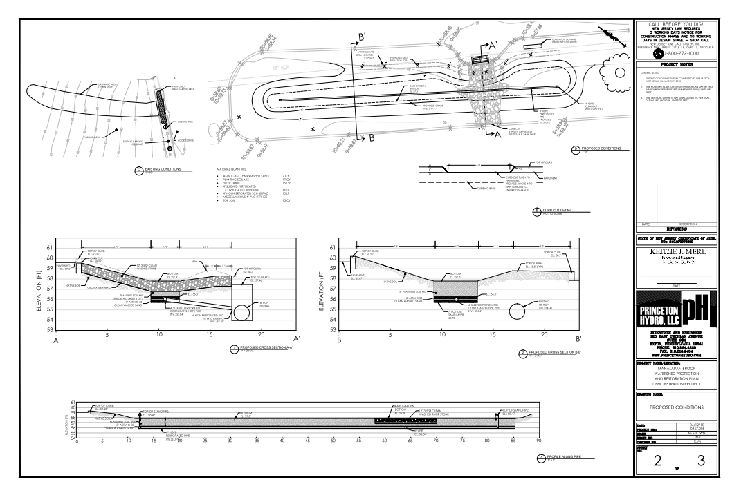

Slide 34
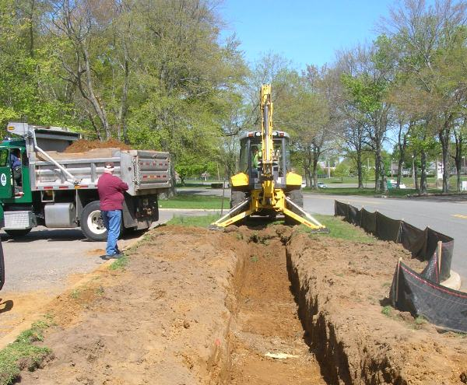


Slide 35
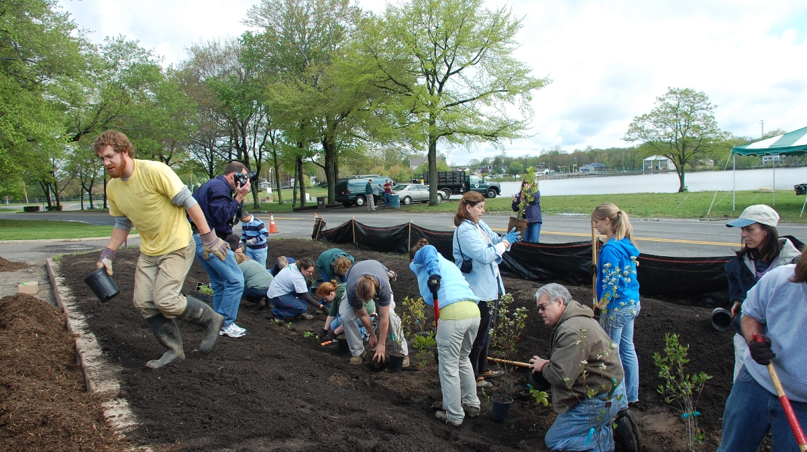

Slide 36
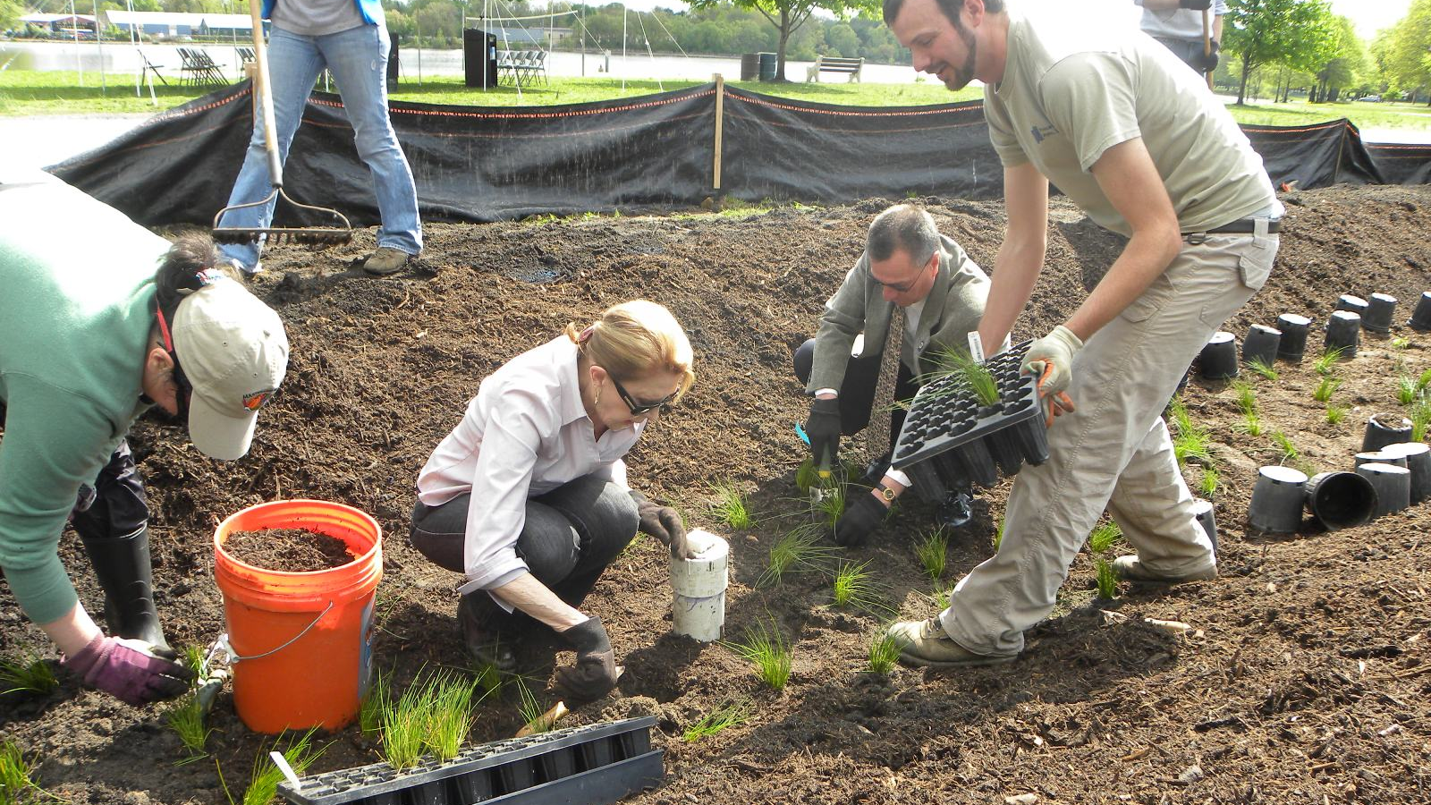

Slide 37
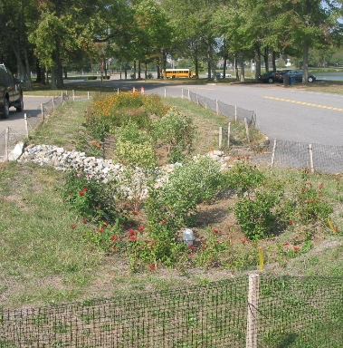
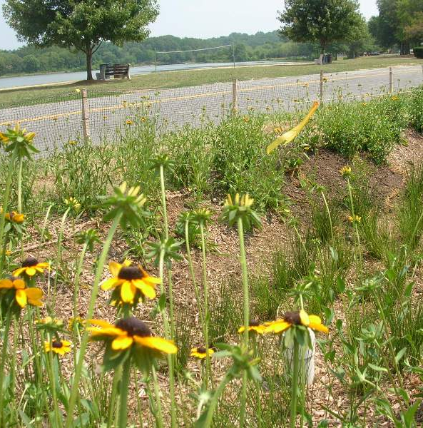

Slide 38
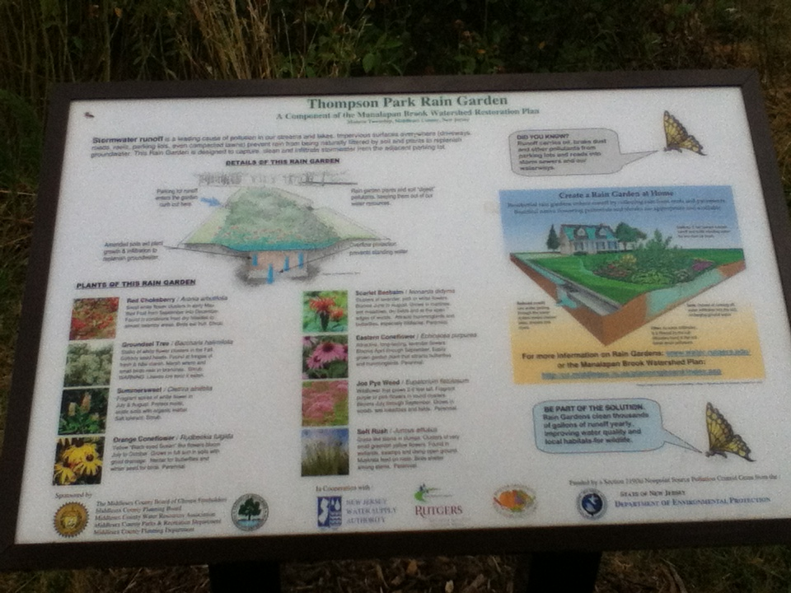

Slide 39
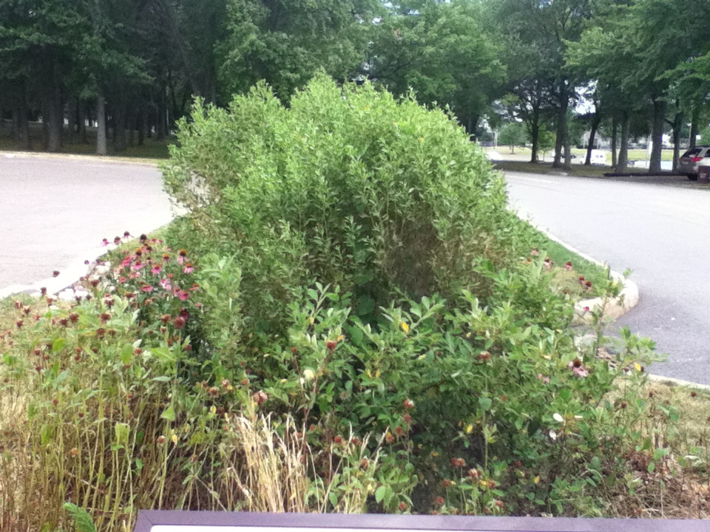

Slide 40
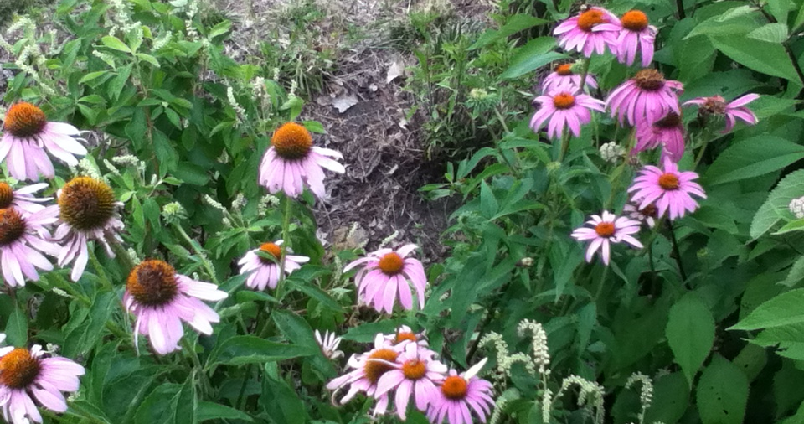

Slide 41
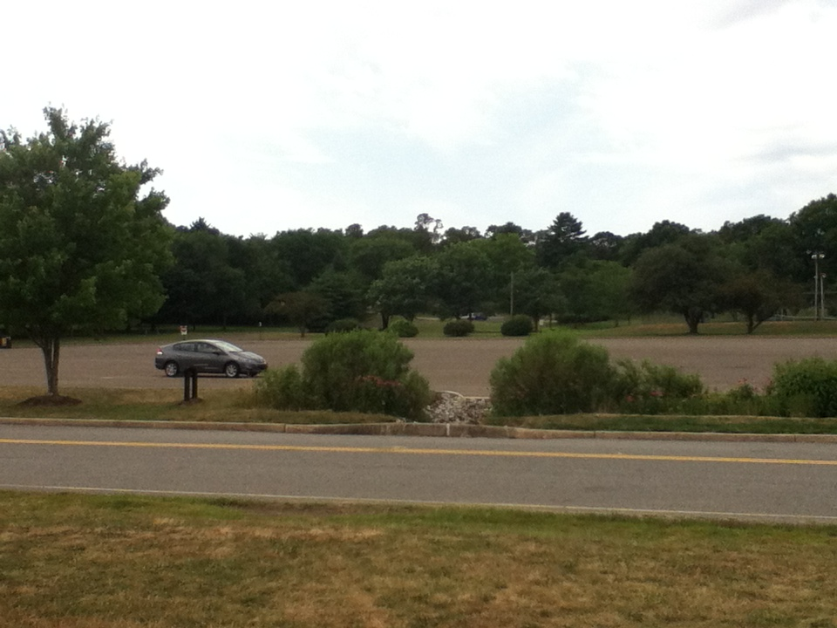

Slide 42
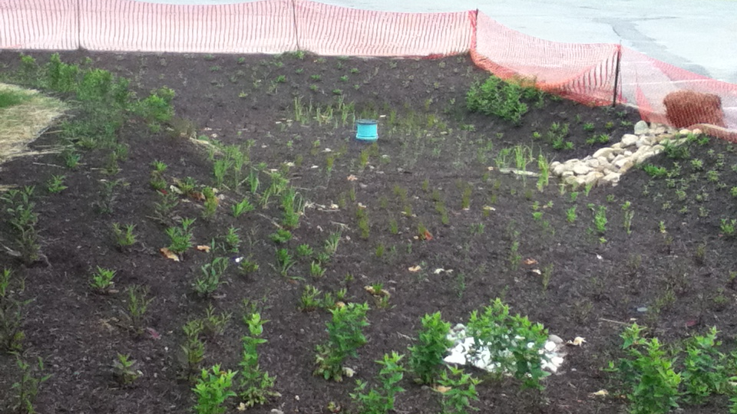
Bioretention Basin (Rain Garden) at the Hopatcong State Park
(June 2012).

Slide 43
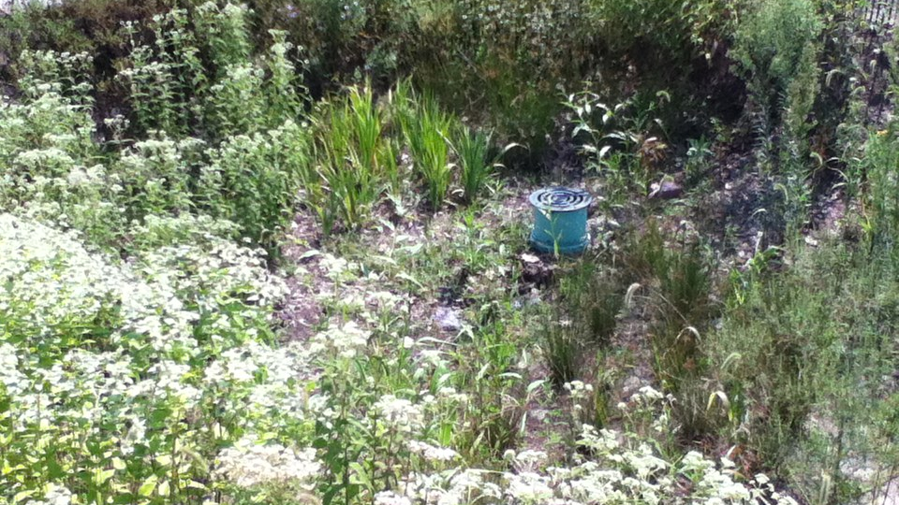
Bioretention Basin (Rain Garden) at the Hopatcong State Park
(August 2013)

Slide 44
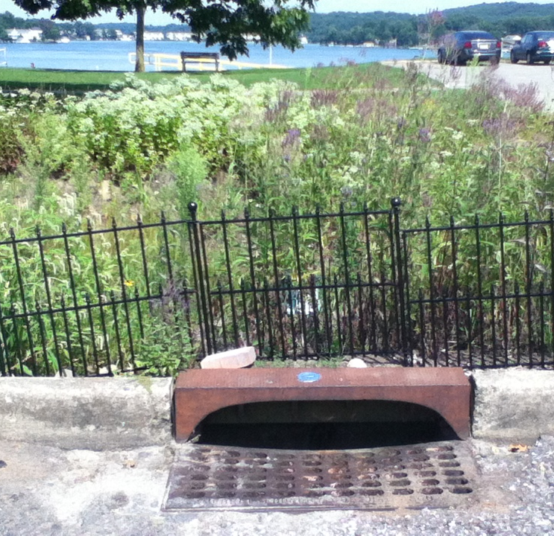
Lake Hopatcong
Bioretention Basin (Rain Garden) at the Hopatcong State Park
(August 2013)

Slide 45
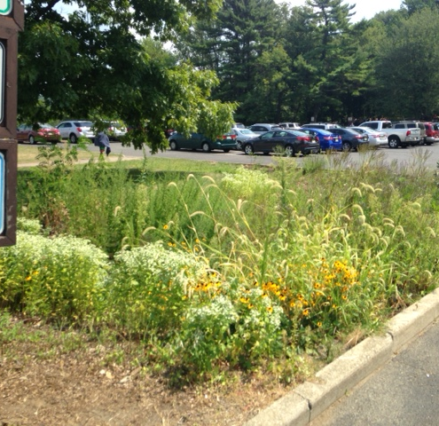
Lake Hopatcong
Bioretention Basin (Rain Garden) at the Hopatcong State Park
(August 2015)

Slide 46
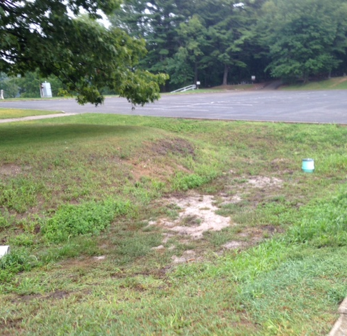
Lake Hopatcong
Bioretention Basin (Rain Garden) at the Hopatcong State Park
(September 2016)

Slide 47
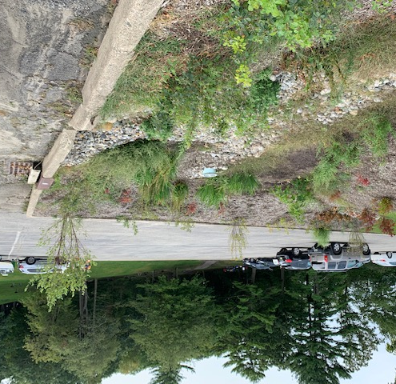
Lake Hopatcong
Bioretention Basin (Rain Garden) at the Hopatcong State Park
(September 2021)

Slide 48
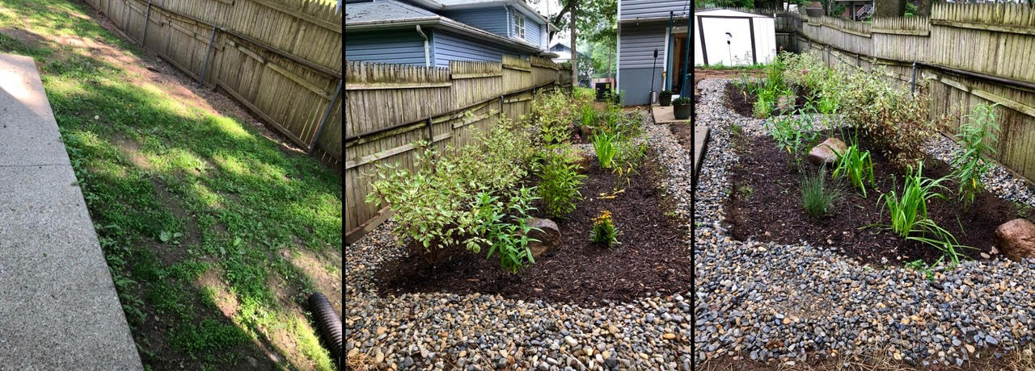
Rutgers Rain Garden Program

Slide 49
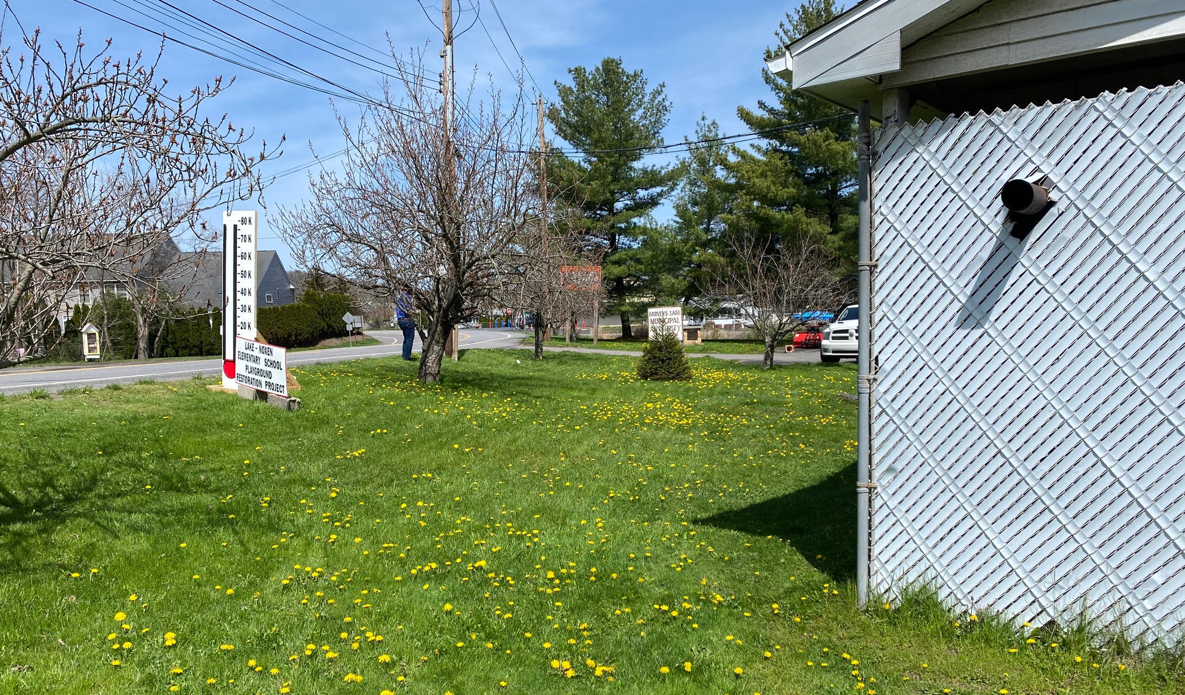
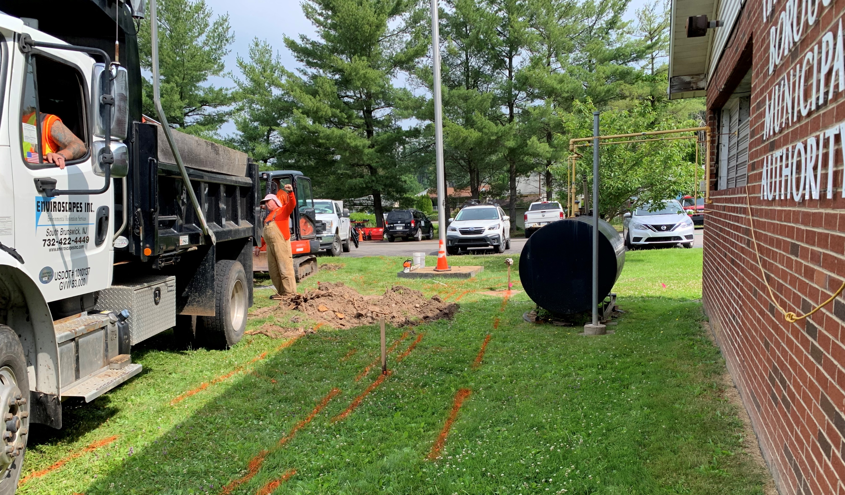
Harveys Lake, Luzerne County, PA
The Borough of Harveys Lake municipal building.
Collecting runoff from the building and associated infrastructure and passing it through a biofiltration system.

Slide 51
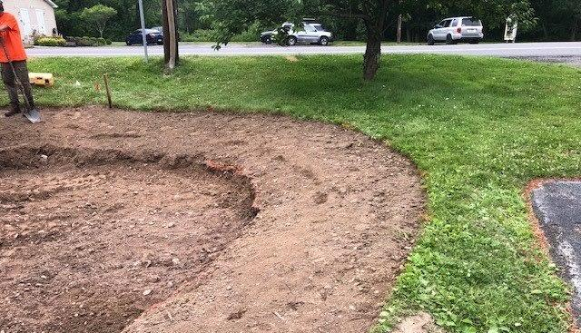
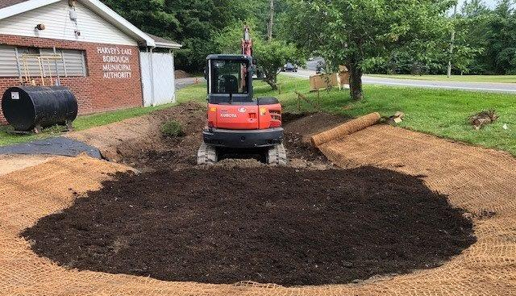
Harveys Lake, Luzerne County, PA
Earthwork and grading to establish the planting zones.
Putting in the biosoil mix (topsoil mixed with organic material).

Slide 52
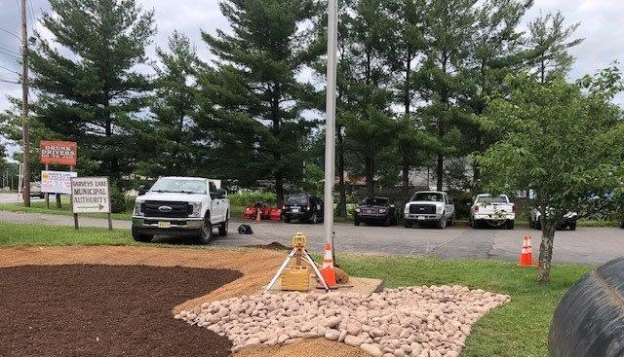
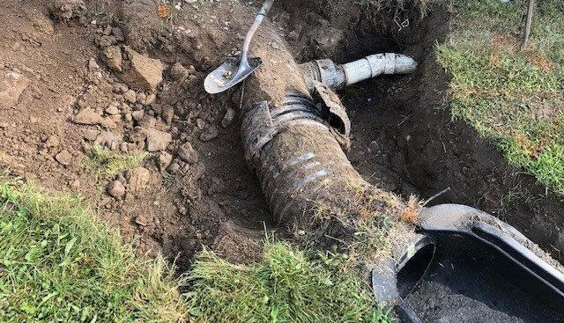
Harveys Lake, Luzerne County, PA
Installation of the stone.
Connecting the stormwater infrastructure to the biofiltration system.

Slide 53
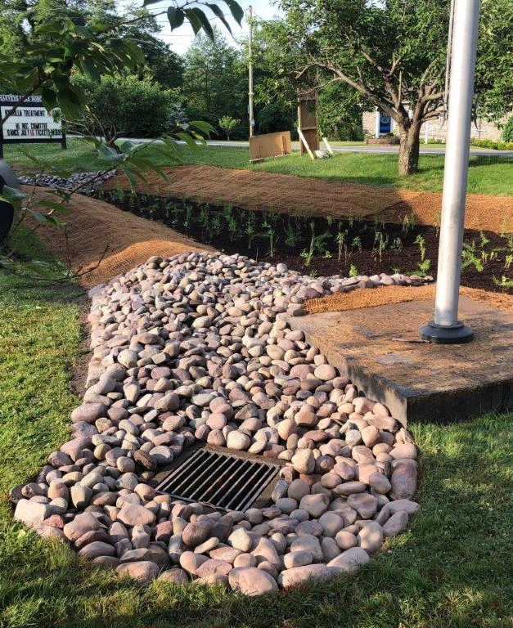
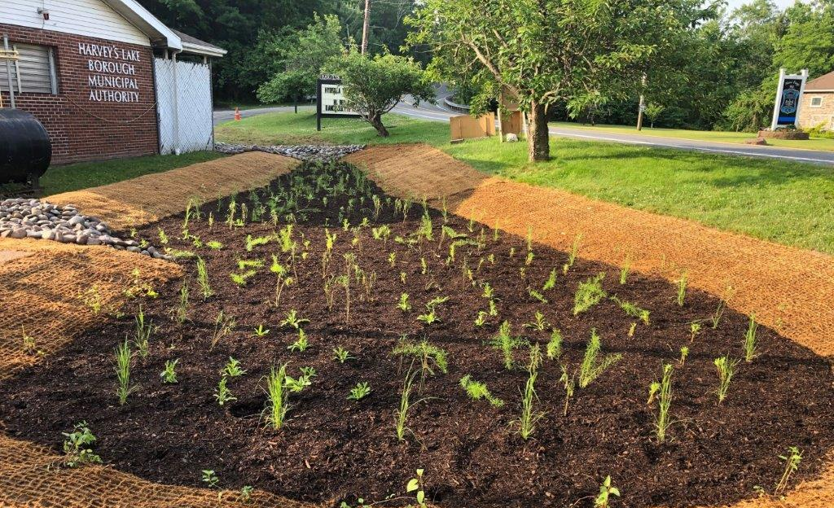
Harveys Lake, Luzerne County, PA
Newly established biofiltration system; installation complete in May 2022.

Slide 54
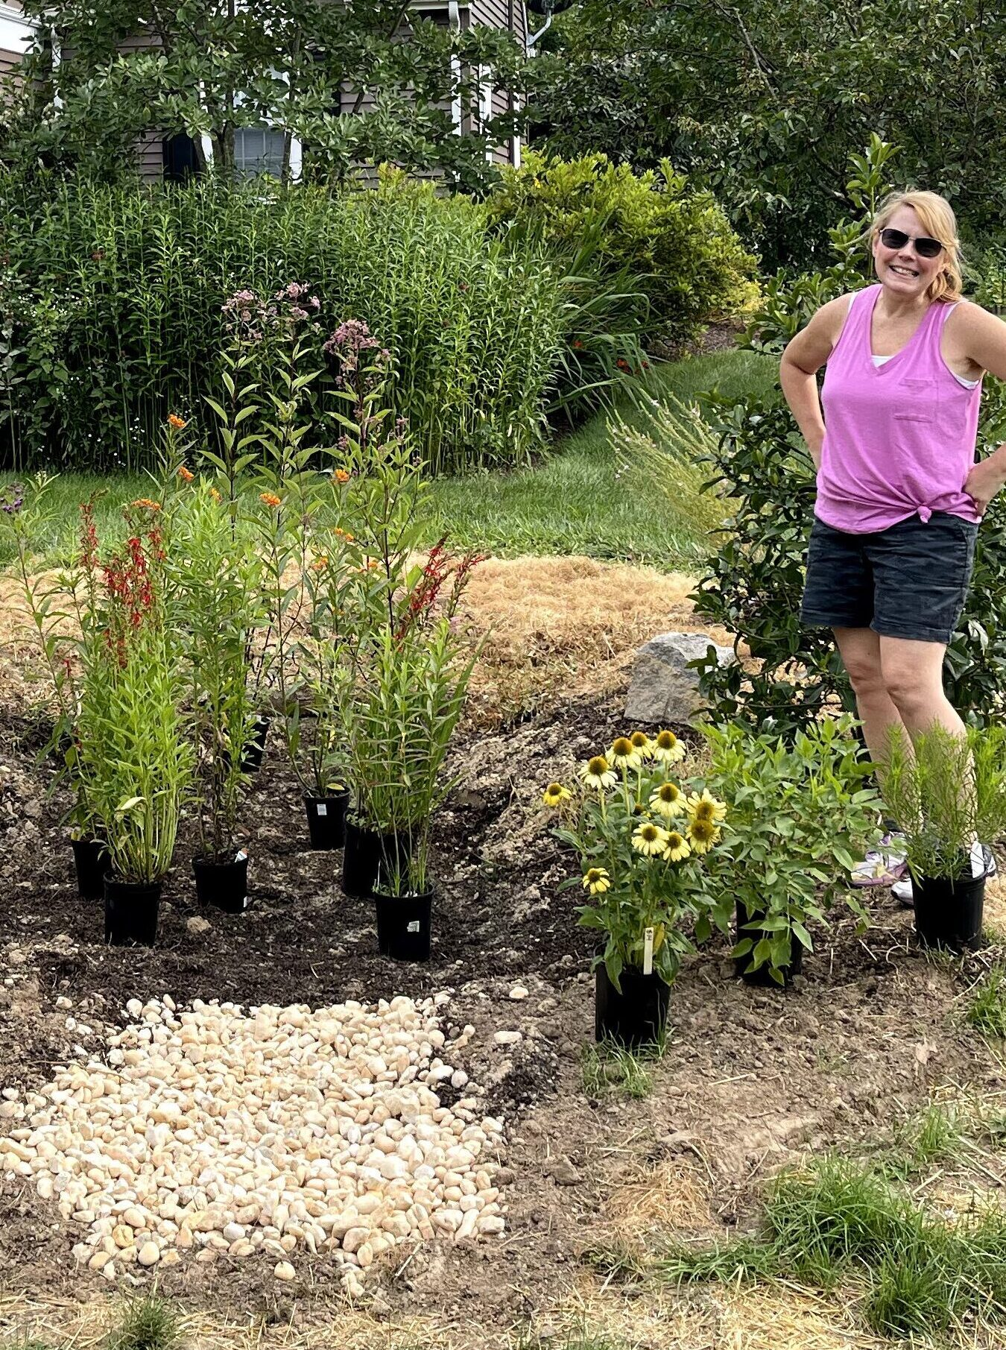
Residential Rain Garden in Yardley
“After repeated stormwater drainage issues near my home’s foundation due to flat topography, I opted to go the environmentally-friendly route of installing a rain garden in my front yard.” – President of Princeton Hydro, Geoffrey Goll, P.E.
How To Build a Rain Garden in 10 Steps - PRINCETON HYDRO

Slide 55
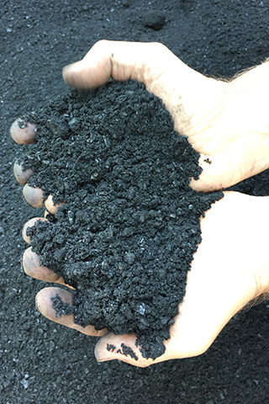
Biochar
Woody material that has been burnt in a controlled fashion.
The high surface area allows it to retain / removal nutrients such as nitrogen and phosphorus.
Princeton Hydro has been using it since 2020 to remove nutrients from lakes, ponds and stormwater structures.
However, can also be used as a soil amendment for Rain Gardens.
Article (pa.gov)

Slide 56
Conclusions
Rain gardens / biofiltration (bioretention) systems can be an effective way of managing the quantify and quality of stormwater for relatively small or medium drainage areas.
A sandy loam soil mixed with organic material is key to the infiltration and operation of the system.
Use native vegetation.
Make the One Call.
Don’t forget about maintenance.

